Slide 1
Global Consensus for the Management of IBD in Pregnancy
Uma Mahadevan MD Millie Long MD MPH
Lynne and Marc Benioff Professor Professor of Medicine
of Gastroenterology
Director, Colitis and Crohn's Disease Center Chief, Division of Gastroenterology and Hepatology
University of California, San Francisco University of North Carolina, Chapel Hill
Funded by The Leona M. and
Harry B. Helmsley Charitable Trust

Slide 2

IBD is often diagnosed during the reproductive years, making it essential
to understand its effects on fertility, pregnancy, and childbirth outcomes.
Notes:
IBD is often diagnosed during the reproductive years, making it critical to understand its effects on fertility, pregnancy, and childbirth outcomes.

Slide 3

Pregnancy represents a period
of intense metabolic, hormonal,
microbiome and immunological changes.
For women with immune-mediated diseases
like IBD, this can increase the risk
of pregnancy complications,
in part due to the unique role of the placenta.
https://urldefense.com/v3/__https:/www.nature.com/nrrheum__;!!LQC6Cpwp!rAgdlwf4ndvYlFOuQrFpVU79uAt2lmcxxkC2tyixkfW_YPgF_ynN6bFTvLhrmuzstzOxU9ZWkYPkwCYPAsrynlOhFx0$"Nature Reviews Rheumatology volume 16, pages113–122 (2020).
Notes:
Pregnancy triggers significant metabolic, hormonal, microbiome, and immunological changes.
The mother's immune system must adapt to the fetus, which carries paternal genes. Pregnancy is therefore considered an immune-suppressive state.
For women with immune-mediated diseases like IBD, this can increase the risk of pregnancy complications, in part due to the unique role of the placenta.

Slide 4
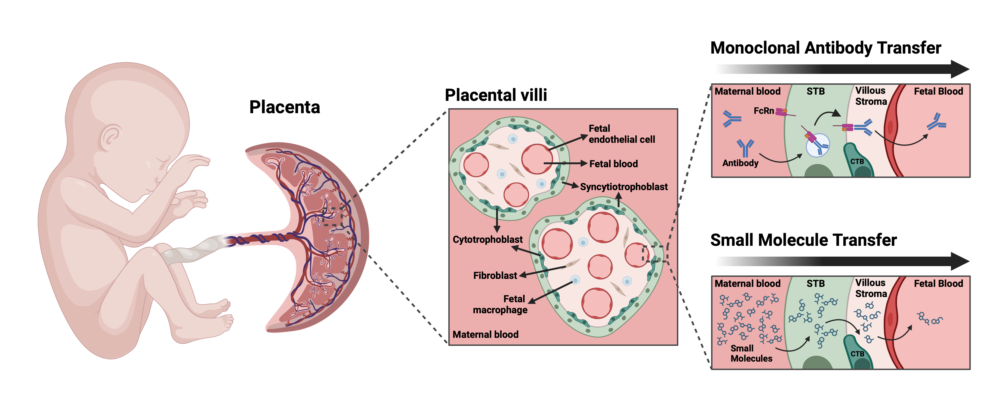
The placenta expresses an equal complement of maternal and paternal genes without eliciting a maternal immune response that rejects the organ.
Image credit: PIANO. PIANO Global Consensus. Accessed September 10, 2024, 2024.
Notes:
The placenta is a unique organ with a highly complex immune function.
Remarkably, the placenta, an embryonic/fetal organ, expresses an approximately equal complement of maternal and paternal genes without eliciting a maternal immune response and rejection of this organ.
Unlike in other animals, the human placenta embeds deeply into the uterus, increasing the complexity of pregnancy and raising risks for conditions like bleeding and placenta-related complications.

Slide 5

There are limited human data
on the safety of new therapies during pregnancy.
For IBD patients, stopping medication increases disease activity, leading to higher risks of maternal and fetal complications.¹
Mahadevan U, Long MD, Kane SV, et al. Pregnancy and Neonatal Outcomes After Fetal Exposure to Biologics and Thiopurines Among
Women With IBD. Gastroenterology. Mar 2021;160(4):1131-1139. doi:10.1053/j.gastro.2020.11.038
Notes:
The interaction between IBD and pregnancy is multi-directional, increasing risks
of maternal, fetal, and obstetric complications.
Due to the exclusion of pregnant women from clinical trials, there are often limited
data on the safety of therapies, leading to a default practice of stopping medications during pregnancy.
For women with IBD, this can result in continued—potentially worsening—disease activity and negative outcomes for both mother and baby.

Slide 6

Background: Global Consensus Group
Universal
guidelines with
consistent interpretation
of data and sensitivity to regional differences
Healthcare professionals and patient advocates from around
the globe
Follows GRADE and
RAND methodologies
Funding: Helmsley Charitable Trust
Notes:
Launched in 2007, PIANO (Pregnancy in IBD and Neonatal Outcomes) is a global registry monitoring medication safety in pregnant women with IBD.
The Global Consensus Group aims to create unified, evidence-based recommendations, accounting for,
and being sensitive to, regional differences.
We are composed of 40 IBD-ologists, 7 content specialists (Grade, MFM, Lactation PharmD, Teratologists, Placental physiologist) 7 patient advocates, with every continent represented.
Using both GRADE and RAND methodologies to form recommendations.

Slide 7
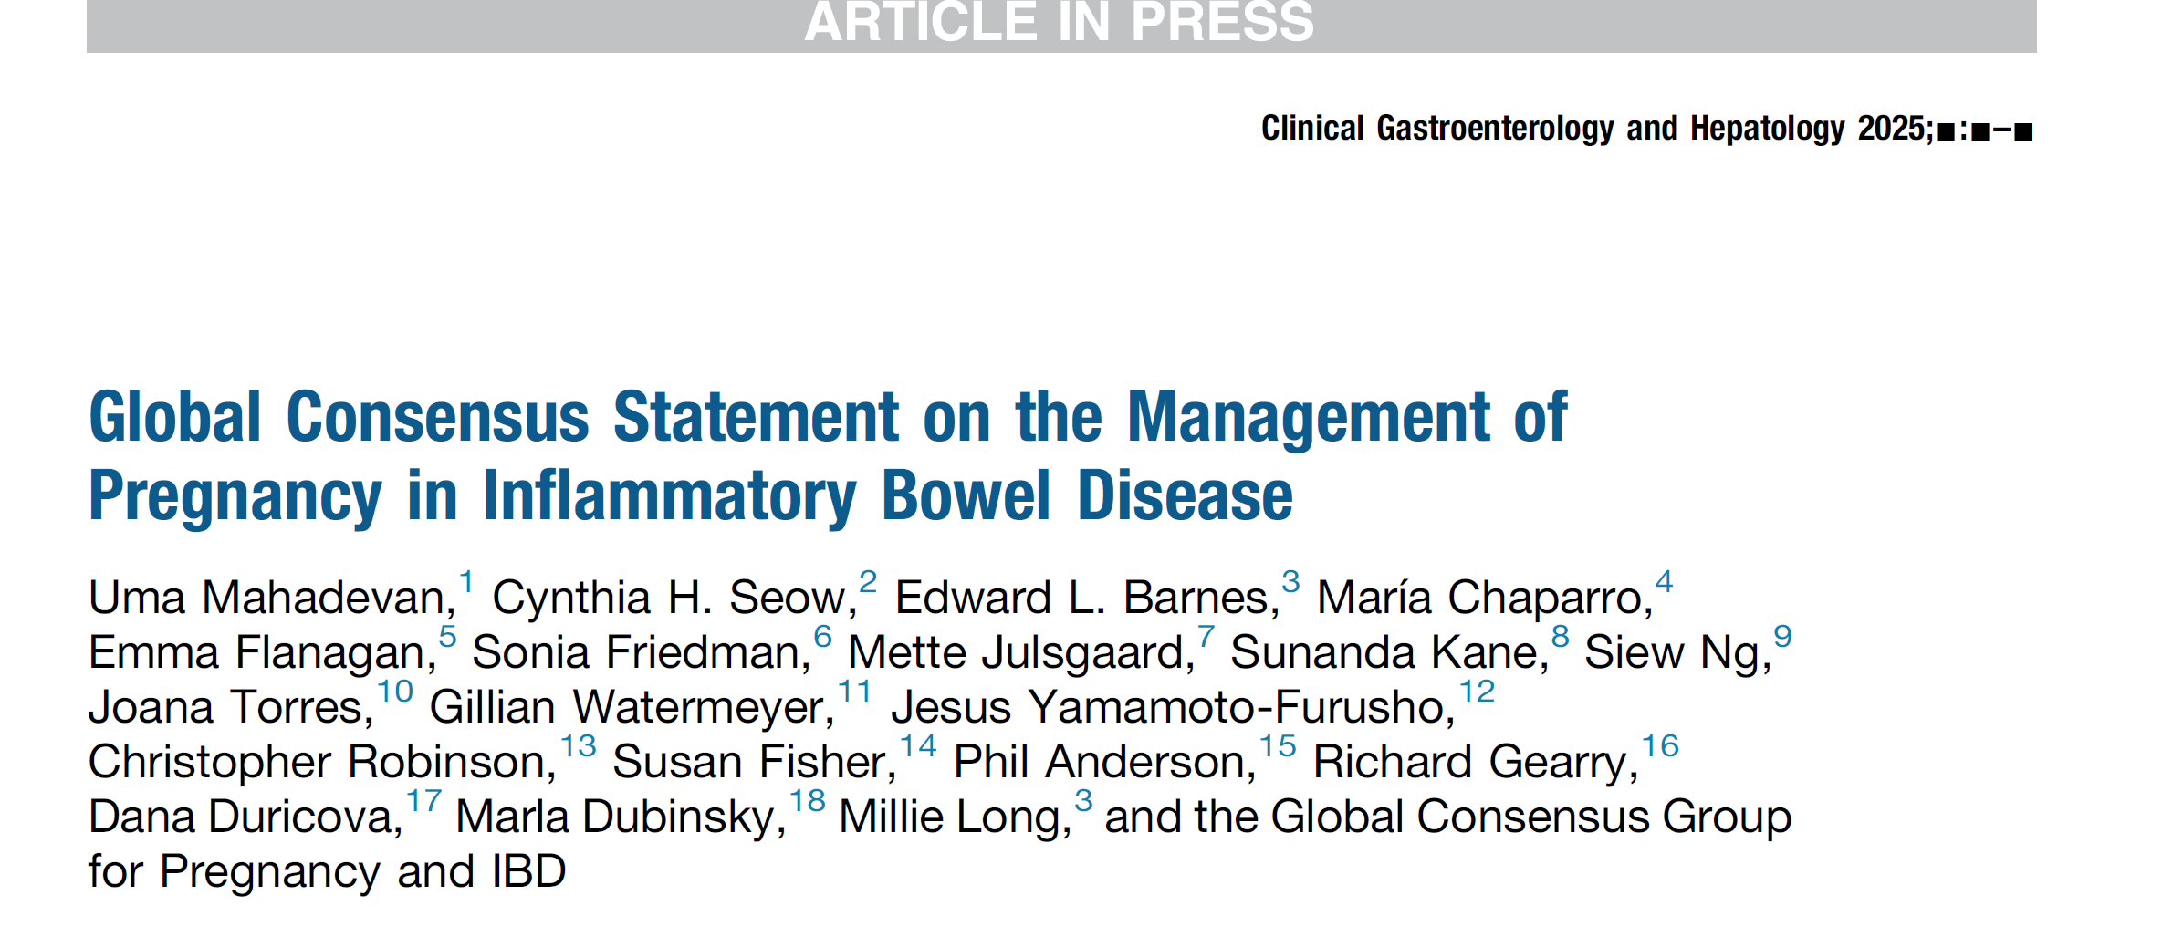
Embargo date: August 22, 2025
Journals:
Clinical Gastroenterology and Hepatology
Gut
American Journal of Gastroenterology
Inflammatory Bowel Diseases
Journal of Crohn’s Colitis
Alimentary Pharmacology and Therapeutics

Slide 8


Global Consensus Physicians

Slide 9




Slide 10

Multidisciplinary Consultants
Phil Anderson PharmD
(Lactation)
Susan Fisher PhD (Placentology)
Tina Chambers PhD
(Teratology)
Chris Robinson MD
(Maternal Fetal Medicine)
Emily Finlayson MD (colorectal surgery)
Notes:
Multidisciplinary consults in lactation, the placenta, teratology, maternal fetal medicine and colorectal surgery participated.

Slide 11
Global Patient Ambassadors
Taiwan
Denmark
Canada
Chile
Australia
Kenya
USA

Slide 12
GRADE
Universal grading for evidence: High, Moderate,
Low, Very Low
Recommendations rated: Strong (benefits > risks)
or Conditional (uncertainty)
Implications: A strong recommendation means most patients would prefer the suggested action, and clinicians should generally offer it
High
Moderate
Low
Very low
Guyatt G, Oxman AD, Akl EA, et al. GRADE guidelines: 1. Introduction-GRADE evidence profiles and summary of findings tables. J Clin Epidemiol. Apr 2011;64(4):383-94. doi:10.1016/j.jclinepi.2010.04.026
Notes:
GRADE stands for Grading of Recommendations, Assessment, Development,
and Evaluation.
It’s a universal system to rate evidence as high, moderate, low, or very low.
Most of the data is low or very low because randomized drug trials are not performed on pregnant women. (A pregnant woman might be in a drug trial, but it won’t be a drug trial
FOR pregnant women).
Recommendations are rated as strong or conditional based on both evidence and patient-reported outcomes, with strong recommendations made when benefits outweigh risks.
The definitions of strong and conditional recommendations are:
strong recommendation — the panel is confident that the desirable effects of adherence to a recommendation outweigh the undesirable effects; and
conditional recommendation — the panel concludes that the desirable effects of adherence to a recommendation probably outweigh the undesirable effects, but is not confident.
Implications of strong and conditional recommendations
The implications of a strong recommendation are:
for patients — most people in your situation would want the recommended course of action and only a small proportion would not; request discussion if the intervention is not offered;
for clinicians — most patients should receive the recommended course of action; and
for policy makers — the recommendation can be adopted as a policy in most situations.
Evidence quality is ranked from high to very low, impacting confidence in recommendations.
The emphasis is on patient-reported outcomes.

Slide 13



RAND Consensus Panel
appropriate
uncertain
inappropriate
Applied when GRADE data are unavailable
Combines evidence
+ expert opinion
0 1 2 3 4 5 6 7 8 9
RAND Disagreement Index (DI)
<1.0 = general agreement
>1.0 = extreme variation
FItch K BS, Aguilar MD, Bernard B, LaCalle JR, Lazaro P, van het Loo M, McDonnell J, Vader JP, Kahan JP. The RAND/UCLA
Appropriateness Method User’s Manual. RAND; 2001
Notes:
The RAND method was applied where GRADE couldn’t be used (due to lack of data), providing expert consensus on limited data.
It is a widely used, iterative, evidence-based process that combines the best available evidence with the expert opinion of the available literature to determine the appropriateness of processes of care in medicine.
For every statement that uses the RAND methodology: on a 1-to-9 scale (1–3: inappropriate, 4–6: uncertain, 7–9: appropriate. Median scores were calculated and rounded up, so that a median score of 3.5 was rated as uncertain whereas a median score of 6.5 was rated as appropriate.
To quantify the level of agreement, a RAND disagreement index (DI) was calculated.
A DI greater than or equal to 1.0 indicates extreme variation whereas DI values less than
1.0 reflect general agreement.

Slide 14







Maternal factors impacting pregnancy
Fertility
Pre-conception counseling and optimization
Management of
disease activity
during pregnancy
Management
of pregnancy
IBD medications
during pregnancy
IBD medications
during lactation
Pregnancy
adverse events
Fetal and neonatal adverse events
Vaccines
Notes:
The Global Consensus focused on 10 key areas in managing IBD during pregnancy.

Slide 15
Maternal factors impacting pregnancy
Fertility
Pre-conception counseling and optimization
Management of
disease activity
during pregnancy
Management
of pregnancy
IBD medications
during pregnancy
IBD medications
during lactation
Pregnancy
adverse events
Fetal and neonatal adverse events
Vaccines
Notes:
There are multiple, often interacting, maternal factors that contribute to IBD risk and pregnancy complications, from genetics to abnormal placentation.

Slide 16
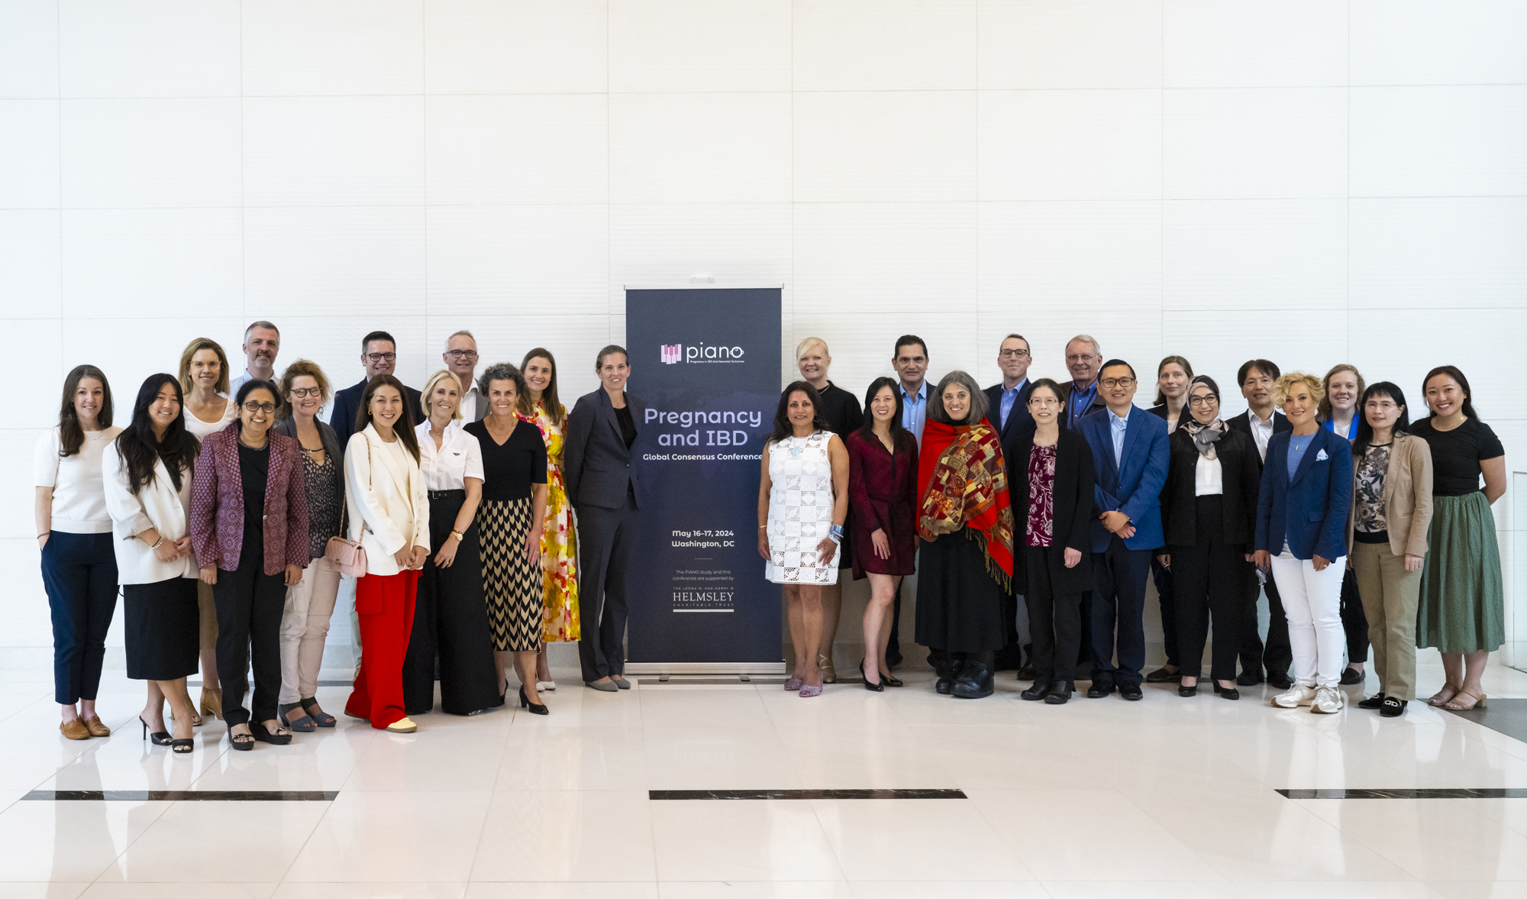

Level of Evidence:
GRADE Statement 1:
Low
We suggest counseling that children with first degree relatives with IBD, as compared to those without, have an increased risk of development of IBD.
Recommendation:
Conditional
Notes:
Genetics play an important part in the pathophysiology of IBD and hence a family history is an important risk factor for developing IBD.
Children of first-degree relatives with IBD have a higher risk of developing IBD compared to those without a family history.

Slide 17
Consensus Statements
1. Children born to a parent with Crohn’s disease may
have a higher risk of developing IBD than children born
to a parent with ulcerative colitis.
Notes:
Children born to a parent with Crohn's disease have a higher risk of developing IBD
than those born to a parent with ulcerative colitis.

Slide 18
Does Maternal Inflammation in Pregnancy Affect Placental Function in Women with IBD?
Maternal inflammation affects placental function and raises the risk
of miscarriage, preterm birth, and small-for-gestational-age infants.
Abnormal placentation
is linked to major obstetrical complications.
It is likely that IBD negatively
affects development or
function of the placenta.
Notes:
Given its rapid growth, decline near birth, and unique functions, it’s not surprising that abnormal placentation is linked to major obstetrical syndromes:
Preterm preeclampsia, marked by sudden hypertension and maternal vascular damage, is linked to shallow placentation and inadequate remodeling of spiral arteries, restricting placental blood flow and impairing fetal growth.
Chronic inflammation, such as foam cells in uterine arteries
Infection (chorioamnionitis) are common causes of preterm labor, with inflammation present in many cases.
Maternal inflammation affects placental function, not just in IBD, but also in conditions like rheumatoid arthritis, psoriasis, and celiac disease.
Increased inflammation raises the risk of miscarriage, preterm birth, and small-for-gestational-age infants.
The impact of pre-existing inflammatory conditions like IBD on pregnancy outcomes is still under investigation.
Since the placenta plays a critical role in both normal pregnancies and complications,
it’s likely that IBD negatively affects its development or function. Whether chronic inflammation is the primary mechanism remains uncertain.
A small study of 14 patients’ placentas showed no signs of inflammation, but more extensive research is needed to draw definitive conclusions.

Slide 19
Placental changes in Vedolizumab treatment treated patients
A
B
37 wks Crohn’s disease
39 wks normal control
C
D
39 wks ulcerative pancolitis
39 wks normal control
Blaisdell et al. 2022. Inflamm Bowel Dis.
Notes:
Significant placental changes, including increased villous and decidual edema, were observed in two patients treated with vedolizumab (left images, A,C) compared to healthy controls (right images, B,D).
The first patient (image A) with Crohn’s and pulmonary hypertension showed placental abnormalities, initially attributed to her overall health. The second patient (image C),
with a healthy pregnancy, also showed abnormal placental development.
These abnormalities led to questions about whether they were due
to vedolizumab treatment or the underlying IBD itself.
Concern arose that vedolizumab might interfere with placentation by blocking alpha-4 beta-7, affecting MAdCAM (expressed by human placental cytotrophoblasts).
A review of PIANO data showed no significant outcome differences between vedolizumab and other biologics.
Further placenta samples from IBD patients on various medications are being collected
to gain more insights.

Slide 20

What Increases IBD Risk in Offspring
Antibiotics
Diet
Maternal Microbiome
Notes:
Prenatal antibiotic use in mothers without IBD is consistently associated with an increased risk
of IBD in infants, according to multiple studies.
Intrauterine antibiotic exposure raises the risk of very early onset IBD in the general population.
Western diet influences IBD risk, even in mothers with IBD. The "Mommy IBD" study found
that higher food additive intake in IBD mothers was linked to infant inflammation.
Maternal diet impacts IBD risk and severity in offspring, potentially through microbiota changes.
However, most data are from mouse models, making it difficult to extrapolate to humans.
Alterations in the maternal microbiome during pregnancy might increase the risk of adverse pregnancy outcomes by causing inflammation and immune dysregulation.
The best evidence to date is based on one human study, MECONIUM Study (2020), which showed that abnormal gut microbiota composition persisted in mothers with IBD during pregnancy and was associated with changes in bacterial diversity and abundance of bacteria species in the infant's stool.¹
There is an ongoing clinical trial called MELODY, which focuses on improving the microbiome of pregnant women with Crohn’s disease through dietary intervention. The goal is to determine if this intervention can restore the microbiome in early life, promoting a healthy immune system in the offspring. Longer follow-up is needed to confirm if this approach can reduce the risk of colitis.
1. Torres, J., Hu, J., Seki, A., Eisele, C., Nair, N., Huang, R., Tarassishin, L., Jharap, B., Cote-Daigneault, J., Mao, Q., et al. (2020). Infants born to mothers with IBD present with altered gut microbiome that transfers abnormalities of the adaptive immune system to germ-free mice. Gut 69, 42-51. 10.1136/gutjnl-2018-317855.

Slide 21
What is the Impact of Prenatal Antibiotics Use on IBD Risk in Offsprings? Body of Evidence (Clinical studies)
Meta-analysis by Agrawal (2021)
  2 high-quality studies, 1 cohort and 1 case-control
  Yes. Risk of IBD with maternal antibiotics → OR 1.75
  (1.22-2.51)
Swedish population-based study (2019)
  Risk of very early onset IBD with intra-uterine antibiotic exposure → adjusted HR 1.93 (1.06-3.50)
  Risk of VEO CD with intra-uterine antibiotic exposure → aHR 2.48 (1.01-6.08)
  But not risk of VOE UC with
  intra-uterine antibiotic exposure → aHR 1.25 (0.47-3.26)
Danish population-based study (2023)
  Risk of IBD with maternal exposure to ≥3 courses of antibiotics in pregnancy → aHR 1.29 (1.03-1.62)
  Risk of UC → aHR 1.45
  (1.06-2.00)
  But not risk of CD → aHR 1.15 (0.83-1.60)
Agrawal et al. EClinicalMedicine 2021
Ortqvist et al. Gut 2019
Agrawal et al. Gut 2023
Notes:
Summary of Findings
Meta-analysis by Agrawal (2021):
2 high-quality studies: 1 cohort, 1 case-control.
Risk of IBD with maternal antibiotic use: OR 1.75 (1.22-2.51).
Sweden Population-Based Study (2019):
Risk of very early-onset IBD with intra-uterine antibiotic exposure: aHR 1.93 (1.06-3.50).
Risk of very early-onset Crohn's disease (CD): aHR 2.48 (1.01-6.08).
No increased risk of very early-onset ulcerative colitis (UC): aHR 1.25 (0.47-3.26).
Denmark Population-Based Study (2023):
Risk of IBD with maternal exposure to ≥3 antibiotic courses in pregnancy: aHR 1.29 (1.03-1.62).
Risk of UC: aHR 1.45 (1.06-2.00).
No increased risk of CD: aHR 1.15 (0.83-1.60).
Meta-analysis of cohort and case-control studies have reported an association between antibiotic exposure during pregnancy and subsequent diagnosis of IBD in the offsprings
(OR 1.75; 95% CI 1.22-2.51; I2 0) ²,³.
In a population-based study, intra-uterine antibiotic exposure was associated with an increased risk of very early onset (VOE)-IBD (adjusted HR (aHR) 1.93; 95% CI 1.06 to 3.50), this risk is increased for Crohn’s disease (CD, aHR 2.48, 95% CI 1.01 to 6.08), but not for ulcerative colitis (UC, HR 1.25, 95% CI 0.47 to 3.26)³.
The highest risk of VEO-IBD was seen in mothers exposed to antibiotics in the third trimester of pregnancy (aHR 2.57, 95% CI 1.10 to 6.01)³.
In a recent population-based study, exposure to ≥3 courses of antibiotics was associated with an increased risk of IBD (aHR 1.29, 95% CI 1.03 to 1.62)⁴. This was driven by UC (aHR 1.45, 95% CI 1.06 to 2.00) but not CD (aHR 1.15, 95% CI 0.83 to 1.60) risk⁴.

Slide 22
Does a Western Diet in IBD Mothers Affect IBD Risk in Offspring?
2 preclinical studies show maternal western diets → increased risk of IBD in offspring
MOMMY-IBD study (2024) – 3 sites in Hong Kong
& Mainland China
  IBD mothers had higher food additive (FA) intake than non-IBD mothers
  FA intake associated with depletion in Bacteroides spp., and enrichment in Streptococcus spp.
  in mothers with IBD
  Fecal calprotectin significantly higher in the gut of infants born to mothers with higher FA intake in IBD and non-IBD groups
MELODY Interventional trial (2020, ongoing)
  Impact of an “IBD-anti-inflammatory diet (AID)”
  on the microbiome of pregnant IBD women
  and the newborn microbiome
Huang et al. Microbiome 2023
Xie et al. Front Immunol 2018
Gilat et al. Scand J Gastroenterol 1987
Zhang et al. DDW 2024
Peter et al. Contemp Clin Trials Commun 2020
Notes:
Summary of Findings:
Preclinical Studies:
Maternal Western diets linked to an increased risk of IBD in offspring.
MOMMY-IBD Study (2024):
Conducted across 3 sites (Hong Kong & Mainland China).
IBD mothers had higher food additive (FA) intake compared to non-IBD mothers.
FA intake associated with:
Depletion of Bacteroides spp. and enrichment of Streptococcus spp.
in IBD mothers.
Higher fecal calprotectin levels in infants of mothers with higher FA intake (both IBD and non-IBD groups).
MELODY Interventional Trial (2020, ongoing):
Investigates the impact of an IBD anti-inflammatory diet (AID) on the microbiome of pregnant IBD women and their newborns.
Mouse studies on effects of various maternal diets on IBD susceptibility in offsprings
In a mouse model of IBD, the Winnie-/- mice (point mutation in the Muc2 gene), resulting in accumulation of aberrant MUC2 within the intestinal goblet cells, leading to activation of endoplasmic reticulum (ER) stress9, investigators supplemented the mother’s diet before conception and up to 6 months after with tomatoes enriched in bioactive polyphenols compared with normal tomatoes. Winnie-/- mice born and nursed by mothers consuming more polyphenols had less dysbiosis and a slight reduction in inflammation. These studies allow careful control over the effect of diet on the maternal and offspring microbiome10.
In mouse models, mothers fed a western diet (high fat, and sugar) had offspring with a higher risk for severe inflammation. Mice born of dams fed a western diet (high-fat/high-sugar (60% high-fat diet supplemented with 12% (w/vol) glucose water, HF/HS) compared to a normal diet had more severe TNBS colitis11. A maternal high fat diet (48% of calories from fat) accelerated severe ileitis in offspring of TNFΔARE mice12. Maternal high fat diet worsens DSS colitis in adult offspring of C57BL/6 mice. The microbiota of the offspring remains changed even after feeding the same diet as control mice13.
The mechanism by which a maternal high fat diet may result in increased susceptibility to IBD includes the finding that offspring of mothers exposed to a HFD (60%) develop a microbiota that is distinct from the maternal microbiome and is characterized by expansion of Firmicutes and a decrease in Gammaproteobacteria (primarily Escherichia). The offspring also have an increase in IL-17-producing type 3 innate lymphoid cells (ILC3s); these are the innate counterpart to Th17 cells. In this model, administration of LPS/PAF results in small intestinal inflammation that is more severe in the offspring of HFD-fed mothers14. Thus, at least in mice, there is compelling evidence that the diet of the mother can impact risk of IBD or severity of IBD in offspring, some through the shaping of the microbiota.

Slide 23
Does Maternal Microbiome Impact Pregnancy and/or Risk of IBD in Offspring?
MECONIUM study (2020) – Mount Sinai
  Abnormal gut microbiota composition persisted in mothers with IBD during pregnancy
  Associated with changes in bacterial diversity and bacteria species in the infant's stool
MOMMY-IBD study (2024)– 3 sites in Hong Kong & Mainland China
  Altered gut bacteria/virome/ fungi in IBD mothers during pregnancy and up to 18 months postpartum
  Reduced “commensal” bacteria strain sharing in IBD mothers and their infants
  Cesarean sections and maternal antibiotic exposure led to decreased vertical transmission of bacterial communities in infants
One preclinical intervention study (2022)
  Maternal Lactobacillus reuteri supplementation shifts intestinal microbiome in mice
  Provides protection from experimental colitis in female offsprings
Torres et al. Gut 2020
Tun et al. DDW 2024
Krishna et al. FASEB Bioadv 2022
Notes:
Summary of Findings:
MECONIUM Study (2020):
Abnormal gut microbiota composition persisted in IBD mothers during pregnancy.
The best evidence to date is based on one human study, which showed that abnormal gut microbiota composition persisted in mothers with IBD during pregnancy and was associated with changes in bacterial diversity and abundance of bacteria species in the infant's stool.³
Linked to changes in bacterial diversity and species in infant stool.
MOMMY-IBD Study (2024):
Altered gut bacteria, virome, and fungi in IBD mothers during pregnancy and up to 18 months postpartum.
Reduced "commensal" bacteria strain sharing between IBD mothers and their infants.
Cesarean sections and maternal antibiotic exposure decreased vertical transmission of bacterial communities
to infants.
Preclinical Intervention Study (2022):
Maternal Lactobacillus reuteri supplementation shifted the intestinal microbiome in mice.
Provided protection from experimental colitis in female offspring.
7. Does maternal microbiome impact pregnancy and/or risk of IBD in offspring?
Alterations in the maternal microbiome during pregnancy may be associated with an increased risk of adverse pregnancy outcomes1. Disruptions in the microbiome can lead to inflammation and immune dysregulation2, which are believed to be involved in the development of pregnancy complications. However, there is currently limited evidence reporting if and how maternal microbiomes impact the risk of IBD (IBD) in offspring. The best evidence to date is based on one human study, which showed that abnormal gut microbiota composition persisted in mothers with IBD during pregnancy and was associated with changes in bacterial diversity and abundance of bacteria species in the infant's stool3. In germ-free mice, a dysbiotic microbiota triggered abnormal imprinting of the intestinal immune system3. Additionally, a preclinical study reported that an antibiotic-perturbed maternal microbiota could be transferred to their offsprings and resulted in worsened colitis in susceptible mice4 , which supports the role of the maternal microbiome in the development of IBD in offspring. Some prevention studies have been reported that aimed to target the maternal microbiome to alleviate intestinal inflammation in offsprings. A preclinical animal study found that maternal Lactobacillus reuteri supplementation altered the gut microbiome in offspring mice and further prevents female offspring from experimental colitis5. There is an ongoing dietary intervention clinical trial MELODY (Modulating Early Life Microbiome through Dietary Intervention in Pregnancy), which aims to improve the microbiome composition of pregnant women with Crohn's disease to determine the effectiveness of dietary intervention in restoring the microbiome during early life in the offspring, thereby promoting priming of a healthy immune system6. Such an approach is promising but longer follow-up will be needed to confirm if dietary intervention in early life can reduce the risk of colitis.
1. Koren, O., Konnikova, L., Brodin, P., Mysorekar, I.U., and Collado, M.C. (2024). The maternal gut microbiome in pregnancy: implications for the developing immune system. Nat Rev Gastroenterol Hepatol 21, 35-45. 10.1038/s41575-023-00864-2.
2. Koren, O., Goodrich, J.K., Cullender, T.C., Spor, A., Laitinen, K., Backhed, H.K., Gonzalez, A., Werner, J.J., Angenent, L.T., Knight, R., et al. (2012). Host remodeling of the gut microbiome and metabolic changes during pregnancy. Cell 150, 470-480. 10.1016/j.cell.2012.07.008.
3. Torres, J., Hu, J., Seki, A., Eisele, C., Nair, N., Huang, R., Tarassishin, L., Jharap, B., Cote-Daigneault, J., Mao, Q., et al. (2020). Infants born to mothers with IBD present with altered gut microbiome that transfers abnormalities of the adaptive immune system to germ-free mice. Gut 69, 42-51. 10.1136/gutjnl-2018-317855.
4. Schulfer, A.F., Battaglia, T., Alvarez, Y., Bijnens, L., Ruiz, V.E., Ho, M., Robinson, S., Ward, T., Cox, L.M., Rogers, A.B., et al. (2018). Intergenerational transfer of antibiotic-perturbed microbiota enhances colitis in susceptible mice. Nat Microbiol 3, 234-242. 10.1038/s41564-017-0075-5.
5. Krishna, M., Engevik, M., Queliza, K., Britto, S., Shah, R., Ruan, W., Wang, H., Versalovic, J., and Kellermayer, R. (2022). Maternal Lactobacillus reuteri supplementation shifts the intestinal microbiome in mice and provides protection from experimental colitis in female offspring. FASEB Bioadv 4, 109-120. 10.1096/fba.2021-00078.
6. Peter, I., Maldonado-Contreras, A., Eisele, C., Frisard, C., Simpson, S., Nair, N., Rendon, A., Hawkins, K., Cawley, C., Debebe, A., et al. (2020). A dietary intervention to improve the microbiome composition of pregnant women with Crohn's disease and their offspring: The MELODY (Modulating Early Life Microbiome through Dietary Intervention in Pregnancy) trial design. Contemp Clin Trials Commun 18, 100573. 10.1016/j.conctc.2020.100573.

Slide 24
Maternal factors impacting pregnancy
Fertility
Pre-conception counseling and optimization
Management of
disease activity
during pregnancy
Management
of pregnancy
IBD medications
during pregnancy
IBD medications
during lactation
Pregnancy
adverse events
Fetal and neonatal adverse events
Vaccines
Notes:
Achieving remission before conception is critical for improving both fertility outcomes
and pregnancy success.

Slide 25

Active IBD
IPAA Surgery
Key factors contributing to reduced fertility
in women with IBD
Lower Ovarian Reserve
Delayed Childbearing
Notes:
Key factors contributing to infertility in women with IBD:
Active IBD: Women with active IBD have higher infertility rates compared to those with inactive disease.
Ileal Pouch-Anal Anastomosis (IPAA): Women who have undergone IPAA surgery experience reduced fertility.
Lower Ovarian Reserve: Women with IBD may have a lower ovarian reserve, indicated by lower anti-mullerian hormone (AMH) levels compared to women without IBD.
Delayed Childbearing: Delaying pregnancy can further impact fertility, especially in women with IBD.

Slide 26
Level of Evidence:
GRADE Statement 2:
Very Low
We suggest counseling that women with IBD may have decreased fertility compared to women without IBD.
Recommendation:
Conditional
Level of Evidence:
GRADE Statement 3:
Very low
In women with ulcerative colitis, we suggest counseling that prior ileal pouch anal anastomosis is associated with decreased fertility when compared to women with ulcerative colitis who have not had ileal pouch anal anastomosis.
Recommendation:
Conditional
Level of Evidence:
GRADE Statement 4:
Very low
In women with IBD, we recommend counseling that active disease increases the risk of infertility as compared to inactive disease.
Recommendation:
Strong
Notes:
Women with IBD have decreased fertility compared to those without IBD.
Women with ileal pouch-anal anastomosis (IPAA) have reduced fertility.
Active IBD is linked to higher infertility rates compared to inactive disease.

Slide 27
Level of Evidence:
GRADE Statement 5:
Very low
We suggest counseling that women with IBD may have comparable effectiveness of assisted reproductive technology when compared
to women without IBD, as measured by live birth .
Recommendation:
Conditional
Level of Evidence:
GRADE Statement 6:
Very low
We suggest counseling that women with IBD who have undergone pelvic surgery with IBD have similar effectiveness of in vitro fertilization when compared to women without IBD, as measured by live birth.
Recommendation:
Conditional
Notes:
Assisted reproduction is comparably effective in women with IBD as in those without.
IVF success rates are similar in women with IBD who have undergone pelvic surgery.

Slide 28
Consensus Statements
2. Women with IBD may have reduced fertility compared to women without IBD due to reduced ovarian reserve.
3. Women with IBD may undergo oocyte retrieval without increased risk of flare.
Inadequate data to vote: Women with IBD may continue all IBD therapy, except methotrexate,
during oocyte retrieval.
Notes:
Women with IBD might experience reduced fertility due to lower ovarian reserve, which
is measured by anti-mullerian hormone (AMH). Studies show women with IBD have lower AMH levels compared to their age-matched peers without IBD.
It’s important to counsel women who plan to delay having children that this may further impact their fertility, especially with IBD.
Another question that arises is whether women can undergo egg freezing. Our consensus was that women with IBD can safely undergo oocyte retrieval without increasing the risk of flare, though the data is limited and based mostly on expert opinion.
Inadequate data to vote: The statement that all therapy could continue during oocyte retrieval wasn’t included, specifically concerning JAK inhibitors, due to theoretical risks to the granulosa cells surrounding the egg.

Slide 29
Maternal factors impacting pregnancy
Fertility
Pre-conception counseling and optimization
Management of
disease activity
during pregnancy
Management
of pregnancy
IBD medications
during pregnancy
IBD medications
during lactation
Pregnancy
adverse events
Fetal and neonatal adverse events
Vaccines
Notes:
Preconception counseling and optimization are strongly recommended for women with IBD.

Slide 30

Level of Evidence:
GRADE Statement 7:
Low
We recommend that women with IBD undergo preconceptional counseling.
Recommendation:
Strong
Notes:
Preconception counseling and optimization might improve medication adherence,
reduce the risk of disease relapse, and lower the risk of low birth weight infants.

Slide 31
Consensus Statements
4. Women with IBD desiring contraception should use long-acting reversible contraception over estrogen containing contraceptives.
5. Women with IBD should be in documented remission and medically optimized prior to
elective conception.
Women with IBD should be in documented remission and medically
optimized prior to elective conception.
Notes:
LARC (Long-Acting Reversible Contraception) is recommended over estrogen-containing oral contraceptives for women with IBD:
More effective by eliminating human error (IUDs, implants).
Avoids issues with medication absorption and interactions (e.g., antibiotics).
Reduces the risk of venous thromboembolism (VTE) associated with estrogen.
Preconception Optimization:
Women with IBD should be in documented remission for at least three months before elective conception.

Slide 32
Contraception Options
1
2
3
Barrier methods: Least effective but protects against STIs (sexually transmitted infections).
Oral contraceptives:
  Combined (estrogen + progesterone): Increased
  risk of VTE (venous thromboembolism), human error, and absorption issues.
  Progesterone-only: No increased VTE risk but still affected by human error
  and absorption.
Long-Acting Reversible Contraception (LARCs):
Most effective, no estrogen,
no increased risk of VTE.
Notes:
Barrier methods: Least effective but protects against STIs.
Oral contraceptives:
Combined (estrogen + progesterone): Increased risk of VTE, human error,
and absorption issues.
Progesterone-only: No increased VTE risk but still affected by human error
and absorption.
LARCs: Most effective, no estrogen, no increased risk of VTE—commonly recommended
in family planning clinics.

Slide 33










Pre-conception counseling and recommendations
Cessation of substances
Vaccinations
Stop teratogenic medications
Preconception Maternal
Fetal Medicine
Achieve disease remission
(3-6 months prior to conception)
IBD treatment plan
Nutritional assessment
and prenatal vitamins
Fertility Specialist
Weight management
Physical activity
Notes:
Pre-conception counseling and recommendations:
Cessation of substances:
Smoking, alcohol, recreational drugs, opioids, cannabis.
Stop teratogenic medications:
Methotrexate (stop 1 month prior).
Jak inhibitors, S1P receptor modulators (refer to medication section).
Achieve disease remission (3-6 months prior to conception):
Clinical and biochemical remission (CRP, fecal calprotectin <150).
Optimize drug levels (thiopurines, anti-TNF agents).
Endoscopic/radiographic remission (ultrasound, MRI, or CT).
Nutritional assessment and prenatal vitamins:
Folic acid 1 month prior (2mg for sulfasalazine users, 5mg for small bowel disease or family history).
Weight management:
Achieve ideal weight and monitor gestational weight gain.
Vaccinations:
Up to date (influenza, Hep B, MMR, varicella).
Live vaccines (MMR, varicella) 28 days prior if not on immunosuppressive therapy.
Preconception Maternal Fetal Medicine:
Maternal-fetal medicine (MFM) or colorectal surgeon if needed.
IBD treatment plan communication:
Ensure all healthcare team members are informed.
Fertility specialist:
Consult if not pregnant after 6 months of timed intercourse.
Encourage regular physical activity

Slide 34
Maternal factors impacting pregnancy
Fertility
Pre-conception counseling and optimization
Management of
disease activity
during pregnancy
Management
of pregnancy
IBD medications
during pregnancy
IBD medications
during lactation
Pregnancy
adverse events
Fetal and neonatal adverse events
Vaccines
Notes:
Effective management of disease activity during pregnancy is crucial to ensure optimal maternal and fetal outcomes, requiring careful monitoring, appropriate use of medications, and timely surgical interventions when necessary.

Slide 35

Level of Evidence:
GRADE Statement 8:
Very low
We suggest that urgent and emergent IBD surgery during pregnancy
be completed when required, and not based on trimester.
Recommendation:
Conditional
Notes:
Surgery should be performed when needed, regardless of trimester.
Prior surgical concerns:
First trimester: Concern for higher risk of miscarriage, no evidence of this in modern era.
Second trimester: considered best time for surgery (no strong data to support this).
Third trimester: Increased difficulty due to space constraints.
Indications for surgery in pregnant IBD patients are similar to non-pregnant patients:
Be aware of hemorrhage, severe colitis, obstruction.

Slide 36
Consensus Statements
6. Endoscopy during pregnancy among women
with IBD is low risk but should only be performed
if it may change management.
7. If cross-sectional imaging is needed during pregnancy, intestinal ultrasound and magnetic resonance imaging without gadolinium are preferred to computed tomography.
8. Fecal calprotectin is useful for monitoring disease activity in pregnant women with IBD.
Notes:
Endoscopy during pregnancy:
Low risk but should only be performed if it might change/improve management
of the disease activity.
Preferred imaging modalities:
Intestinal ultrasound, cross-sectional imaging, and MRI with gadolinium are preferred over CT.
Single CT scan: Radiation exposure is below harmful levels.
Monitoring:
Fecal calprotectin is useful for monitoring disease activity in pregnant women with IBD.

Slide 37
 | Assessment of Disease Activity | Comment
Laboratory Tests | Serum Inflammatory markers C Reactive Protein, Sedimentation Rate | Can be elevated from pregnancy
 | Fecal Calprotectin | Effective for monitoring in pregnancy
 | Serum Drug Concentrations | May vary in pregnancy
Cross-sectional imaging | Intestinal Ultrasound | Low risk: Accurate in trimester 1,2 but technically challenging in trimester 3
 | Computed Tomography | Relatively safe. The cumulative radiation exposure of a single CT scan (~ 50 mGy) is below the level of concern
 | Magnetic Resonance Imaging | Low risk. Avoid gadolinium (potential teratogen) during first trimester
Procedures | Endoscopy | Low risk: Can be performed if indicated and will change management
 | Surgery | Perform if indicated regardless of trimester. Should be done at expert centers Indications: acute refractory colitis, perforation, abscess, refractory hemorrhage, bowel obstruction
Notes:
Assessing Disease Activity During Pregnancy

Slide 38
Maternal factors impacting pregnancy
Fertility
Pre-conception counseling and optimization
Management of
disease activity
during pregnancy
Management
of pregnancy
IBD medications
during pregnancy
IBD medications
during lactation
Pregnancy
adverse events
Fetal and neonatal adverse events
Vaccines
Notes:
Management of pregnancy in women with IBD focuses on controlling disease activity, preventing complications, and ensuring maternal and fetal health.

Slide 39
Level of Evidence:
GRADE Statement 9:
Low
We suggest that pregnant women with IBD take low dose aspirin by 12-16 weeks gestation to prevent preterm pre-eclampsia.
Recommendation:
Conditional
Level of Evidence:
GRADE Statement 10:
Very low
We suggest that pregnant women with Crohn's disease and active perianal disease undergo cesarean delivery.
Recommendation:
Conditional
Level of Evidence:
GRADE Statement 11:
Very low
We suggest that pregnant women with IBD and prior ileal pouch anal anastomosis consider cesarean delivery.
Recommendation:
Conditional
Notes:
Low dose aspirin:
Recommended for pregnant women with IBD by 12 to 16 weeks gestation
to prevent preterm preeclampsia (new recommendation).
Some recommend stopping at 36 weeks to reduce the risk of bleeding during delivery.
Cesarean section:
Recommended for pregnant women with Crohn's disease and active perianal disease.
Suggested for pregnant women with IBD and prior IPAA to reduce the risk of pouch function decline from vaginal delivery.
Data is conflicting, but the only study by Feso Rezi using manometry showed lower squeeze pressures and more sphincter defects with vaginal delivery
in women with a J-pouch.

Slide 40
Consensus Statements
9. Pregnancies for women with IBD should be considered as high risk for complications.
10. Women with current or past history
of rectovaginal fistulas should deliver by
cesarean delivery.
11. Women with IBD should be assessed early in pregnancy or preconception for nutritional status, weight gain and micronutrient deficiency.
Notes:
High-risk pregnancy:
Pregnancies in women with IBD are considered high risk.
A high-risk pregnancy threatens the health of the mother or fetus, and while women with IBD are often young and otherwise healthy, they are not always recognized as high-risk despite the link to adverse maternal and obstetric outcomes, especially with uncontrolled disease activity.
Cesarean section:
Recommended for women with current or past history of rectovaginal fistulas.
Nutritional assessment:
Women with IBD should be assessed early in pregnancy or preconception for nutritional status.
Women with IBD are at risk of malnutrition and micronutrient deficiencies due
to factors like malabsorption and uncontrolled disease, which may be worsened during pregnancy due to increased nutritional demands, with common deficiencies including iron, vitamin B12, vitamin D, and folic acid, potentially affecting maternal and fetal outcomes.
Expected weight gain during pregnancy is 20 to 25 pounds; failure to meet this is linked to increased adverse events, such as preterm delivery, SGA and admission to neonatal intensive care unit.
Failure to achieve appropriate weight targets should prompt referral to a dietician. Patients with risk factors for malnutrition, such as extensive small bowel surgery, should also be referred to a dietician.

Slide 41
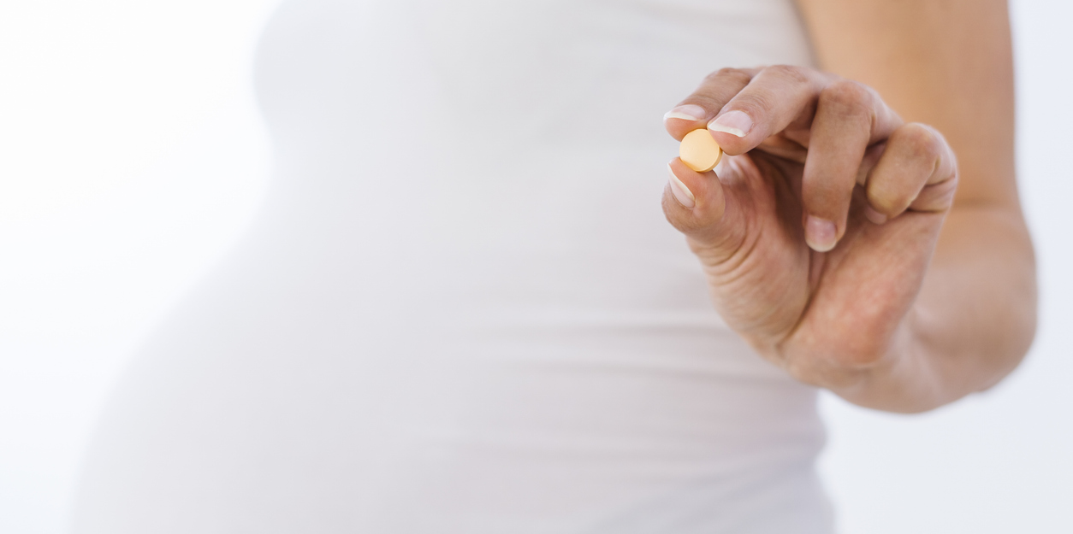

Pre-eclampsia is one of the leading causes of maternal and perinatal morbidity and mortality.
Women with IBD may have an increased risk of preterm pre-eclampsia.
Low dose aspirin may prevent
pre-eclampsia in at-risk patients.
Boyd et al, PLOS One, 2015
Tarar et al, Int J Colorectal Dis, 2022
Rolnik et al NEJM, 2017, Duley et al, Cochrane Database Syst Rev, 2019, Boyd et al PLOS One, 2015, Prakash et al Inflamm Bowel Dis, 2023, Stephansson et al, Clin Gastroenterolo Hepatol, 2010, Tandon et al Aliment Pharmacol Ther, 2020, Patel et al, Inflamm Bowel Dis, 2021, DeBolt et al, Dig Dis Sci. 2024, Yu et al, ACG ASM, 2023.
Notes:
Pre-eclampsia (PE) typically affects 2%–5% of pregnant women and is one of the leading causes of maternal and perinatal morbidity and mortality
Low dose aspirin may prevent pre-eclampsia in at-risk patients
No evidence of Increased risk of IBD flare in women taking low dose aspirin (ASPRE study)
Studies support GRADE and Consensus statements:
Danish national cohort study: Increased risk of severe preeclampsia in IBD patients.
Berkeley Otitis group study: Preeclampsia and eclampsia were higher in Crohn’s disease patients (national inpatient survey).
ASPRE study (New England Journal of Medicine):
Found higher rates of preeclampsia in IBD.
Recommended aspirin dosage was 150 mg (common practice uses
81 mg twice).
Must start aspirin around 11-16 weeks of gestation, stop at 36 weeks
to reduce bleeding risk during delivery.
Aspirin is stopped at end of week 36 as now no longer preterm and this may reduce risk of bleeding with delivery

Slide 42
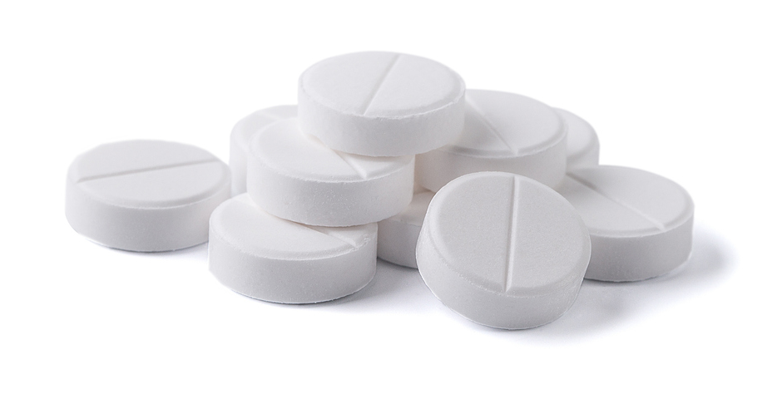
Low dose aspirin may prevent pre-eclampsia in at-risk patients
ASPRE study
  RCT: aspirin at a dose of 150 mg/day, from 11-14 36 weeks of gestation given to women at high-risk
  for preterm pre-eclampsia*
  ASPRE study 13/798 (aspirin) vs 35/822 (placebo), aOR 0.38 [0.2-0.7]
  Women at high risk of preeclampsia without IBD benefit from low dose aspirin started <16 weeks
No evidence of Increased risk of IBD flare in women taking low dose aspirin
  Retrospective cohort studies only
Must be started by week 12-16 gestation
Consideration for stopping at week 36 to reduce risk of bleeding
* maternal factors, mean arterial pressure, uterine-artery pulsatility index, and maternal serum pregnancy-associated plasma protein A and placental growth factor
Rolnik et al NEJM, 2017, Duley et al, Cochrane Database Syst Rev, 2019, Boyd et al PLOS One, 2015, Prakash et al Inflamm Bowel Dis, 2023, Stephansson et al, Clin Gastroenterolo Hepatol, 2010, Tandon et al Aliment Pharmacol Ther, 2020, Patel et al, Inflamm Bowel Dis, 2021, DeBolt et al, Dig Dis Sci. 2024, Memel et al Am J of Gastroenterol 2024

Slide 43
Women with IBD may have an increased risk of preterm pre-eclampsia
Pre-eclampsia (PE) typically affects 2%–5% of pregnant women and is one of the leading causes of maternal and perinatal morbidity and mortality
Danish National Birth Cohort (>85,000 women) 1996-2002
  CD 278, UC 388
  Overall preeclampsia rate not elevated HR 1.21 [0.76-1.95]
  Severe preeclampsia elevated
  in women with IBD HR 2.24 [1.05-4.8]
National inpatient survey
(US 2016-2018)
  8,079,828 pregnancies
  (CD 8,475, UC 5,665)
  CD preeclampsia / eclampsia aOR 1.52 [1.15-2.02]
  UC preeclampsia / eclampsia aOR 1.05 [0.68-1.64]
Boyd et al, PLOS One, 2015
Tarar et al, Int J Colorectal Dis, 2022

Slide 44

What does “high risk pregnancy” mean in different health care environments?
  Specialist IBD pregnancy clinics
  Maternal-Fetal medicine clinics
  Education for midwives concerning risks
  and what to look for
Notes:
High-risk pregnancy management:
Definition of "high-risk" differs globally.
In some countries, care may be provided primarily by midwives, not physicians
or MFMs (Maternal-Fetal Medicine specialists), until after 24 weeks, or even throughout pregnancy.
High-risk care for IBD pregnancies could involve specialized clinics or MFMs, depending on country protocols.
Regardless, all those involved should be properly educated on risk and monitoring.

Slide 45
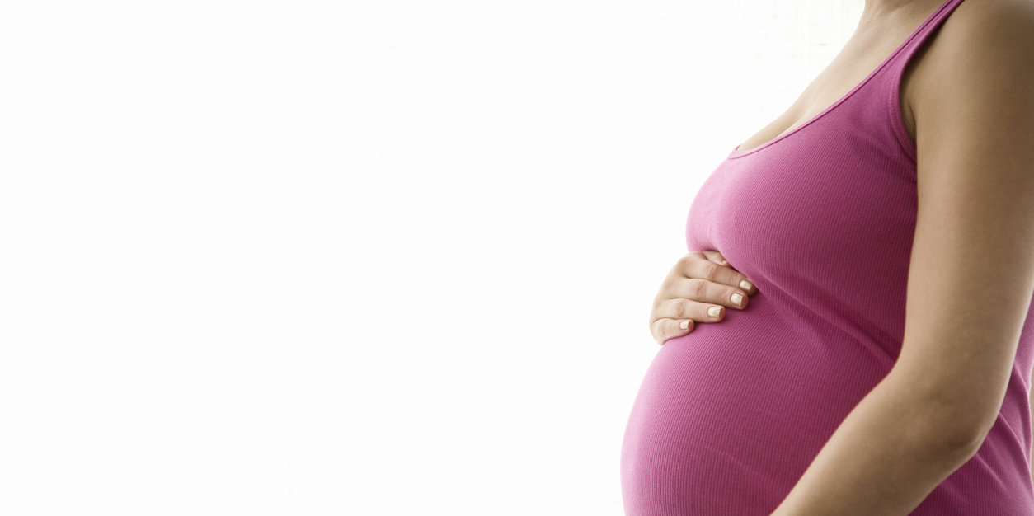
Caesarean delivery for women with prior IPAA
Conflicting data on the impact of vaginal delivery in women with IPAA
  Systematic review of 8 studies (358 patients) –
  no difference in pouch function except for complicated VD
  One study showed reduced squeeze pressure, more sphincter defects and worse QoL in women having VD compared to CS
Foulon et al, Inflamm Bowel Dis, 2017, Remzi et al Dis Colon Rectum, 2005.
Notes:
J-pouch and delivery mode:
Data are conflicting, but the only study by Feza Remzi using manometry showed lower squeeze pressures and more sphincter defects with vaginal delivery in women with a J-pouch.

Slide 46
Maternal factors impacting pregnancy
Fertility
Pre-conception counseling and optimization
Management of
disease activity
during pregnancy
Management
of pregnancy
IBD medications
during pregnancy
IBD medications
during lactation
Pregnancy
adverse events
Fetal and neonatal adverse events
Vaccines
Notes:
The use of IBD medications in pregnancy remains one of the most controversial areas
in the management of patients with IBD.

Slide 47
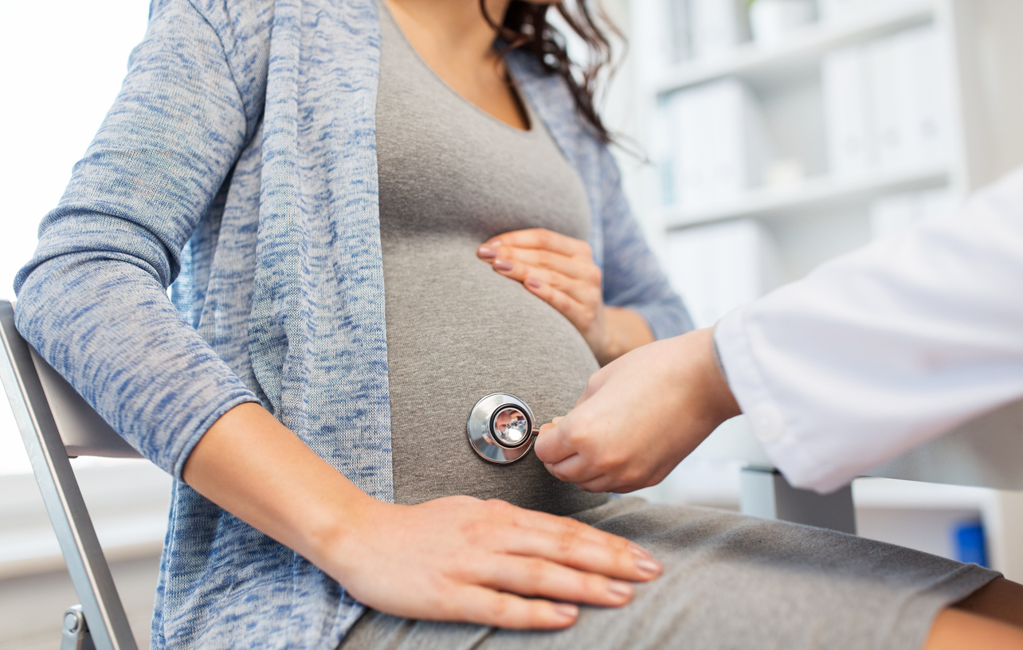
Evolving guidelines emphasize controlling disease activity for both maternal and fetal health.
Yet taking IBD medication might not be safe for mother and child.
Yet taking IBD medications have limited safety data for mother and child.
  Deescalating therapy or stopping biologics before the third trimester led to more disease flares.
  Deescalating therapy or stopping biologics before the third trimester led to more disease flares.
Notes:
As already mentioned, IBD potentially has a negative impact on pregnant mothers and fetuses.
Evolving guidelines emphasize controlling disease activity for both maternal and fetal health.
Yet taking IBD medications have limited safety data for mother and child.
A systematic review and meta-analysis found that deescalating therapy or stopping biologics before the third trimester led to more disease flares.

Slide 48
Medications in Pregnancy
1
Pregnant women are not included in IBD clinical trials
2
Unmeasured confounding is innate to uncontrolled studies
3
Existing disease activity impacts decision to continue or discontinue therapy – the decision is not random!
4
Low event rates for adverse events
5
Small cohort sizes
6
Congenital malformations occur in 5-8% of all births
7
Preterm birth (9.9% of births) predisposes to neonatal infection
Notes:
Challenges in controlling disease activity:
Pregnant women are not included in clinical trials, so medication data in this population is limited.
Unmeasured confounding is common in uncontrolled studies:
Patients who start or continue IBD medications during pregnancy are not all the same; decisions are often influenced by existing disease activity.
The choice to continue or stop therapy is not random.
It might be influenced by disease severity or other underlying conditions.
If these factors aren’t measured or adjusted for in the analysis, they can skew the results, making it difficult to determine the actual effect of the medication on pregnancy outcomes.
Low event rates for adverse events and small cohort sizes affect data reliability.
There is an underlying risk of birth defects in the general population, complicating assessments.
Preterm birth increases the risk of neonatal infections.

Slide 49
Global Consensus Manuscript 2024
Notes:
Here is what we know:
The placenta plays a key role in medication safety during pregnancy.
As seen in the image, the placenta villi serve as the pathway for the exchange of antibodies and small molecules between the maternal and fetal circulatory systems
Syncytiotrophoblast (STB): The outer layer in direct contact with
maternal blood.
Cytotrophoblast (CTB): Underlying layer supporting the syncytiotrophoblast.
Fetal endothelial cells: Form the walls of fetal blood vessels.
Fetal macrophages and fibroblasts: Found within the villi.
During the key period of organogenesis, which is week three to eight, there should be no exposure to biologics.
Monoclonal antibodies are too large to cross the placenta early but begin actively transferring across the placenta via Fc receptors around week 14.
The FcRn receptor helps antibodies cross the syncytiotrophoblast into
the fetal blood, providing passive immunity to the fetus.
80% of monoclonal antibody transfer occurs in the third trimester.
As key organogenesis occurs between week 2-8 gestation, monoclonal antibodies are generally safe to continue through pregnancy, with low risk of birth defects.
However, small molecules cross the placenta throughout pregnancy, including JAK inhibitors, raising concerns about potential teratogenicity.
Small molecules also pass from maternal blood through the syncytiotrophoblast and cytotrophoblast layers into the fetal blood.
This transfer is typically simpler due to the size and nature of small molecules.
Maternal antibodies (and biologic agents) cross the placenta to provide protection to the infant, but biologics can also persist after birth. However, small molecules should clear quickly after delivery.

Slide 50
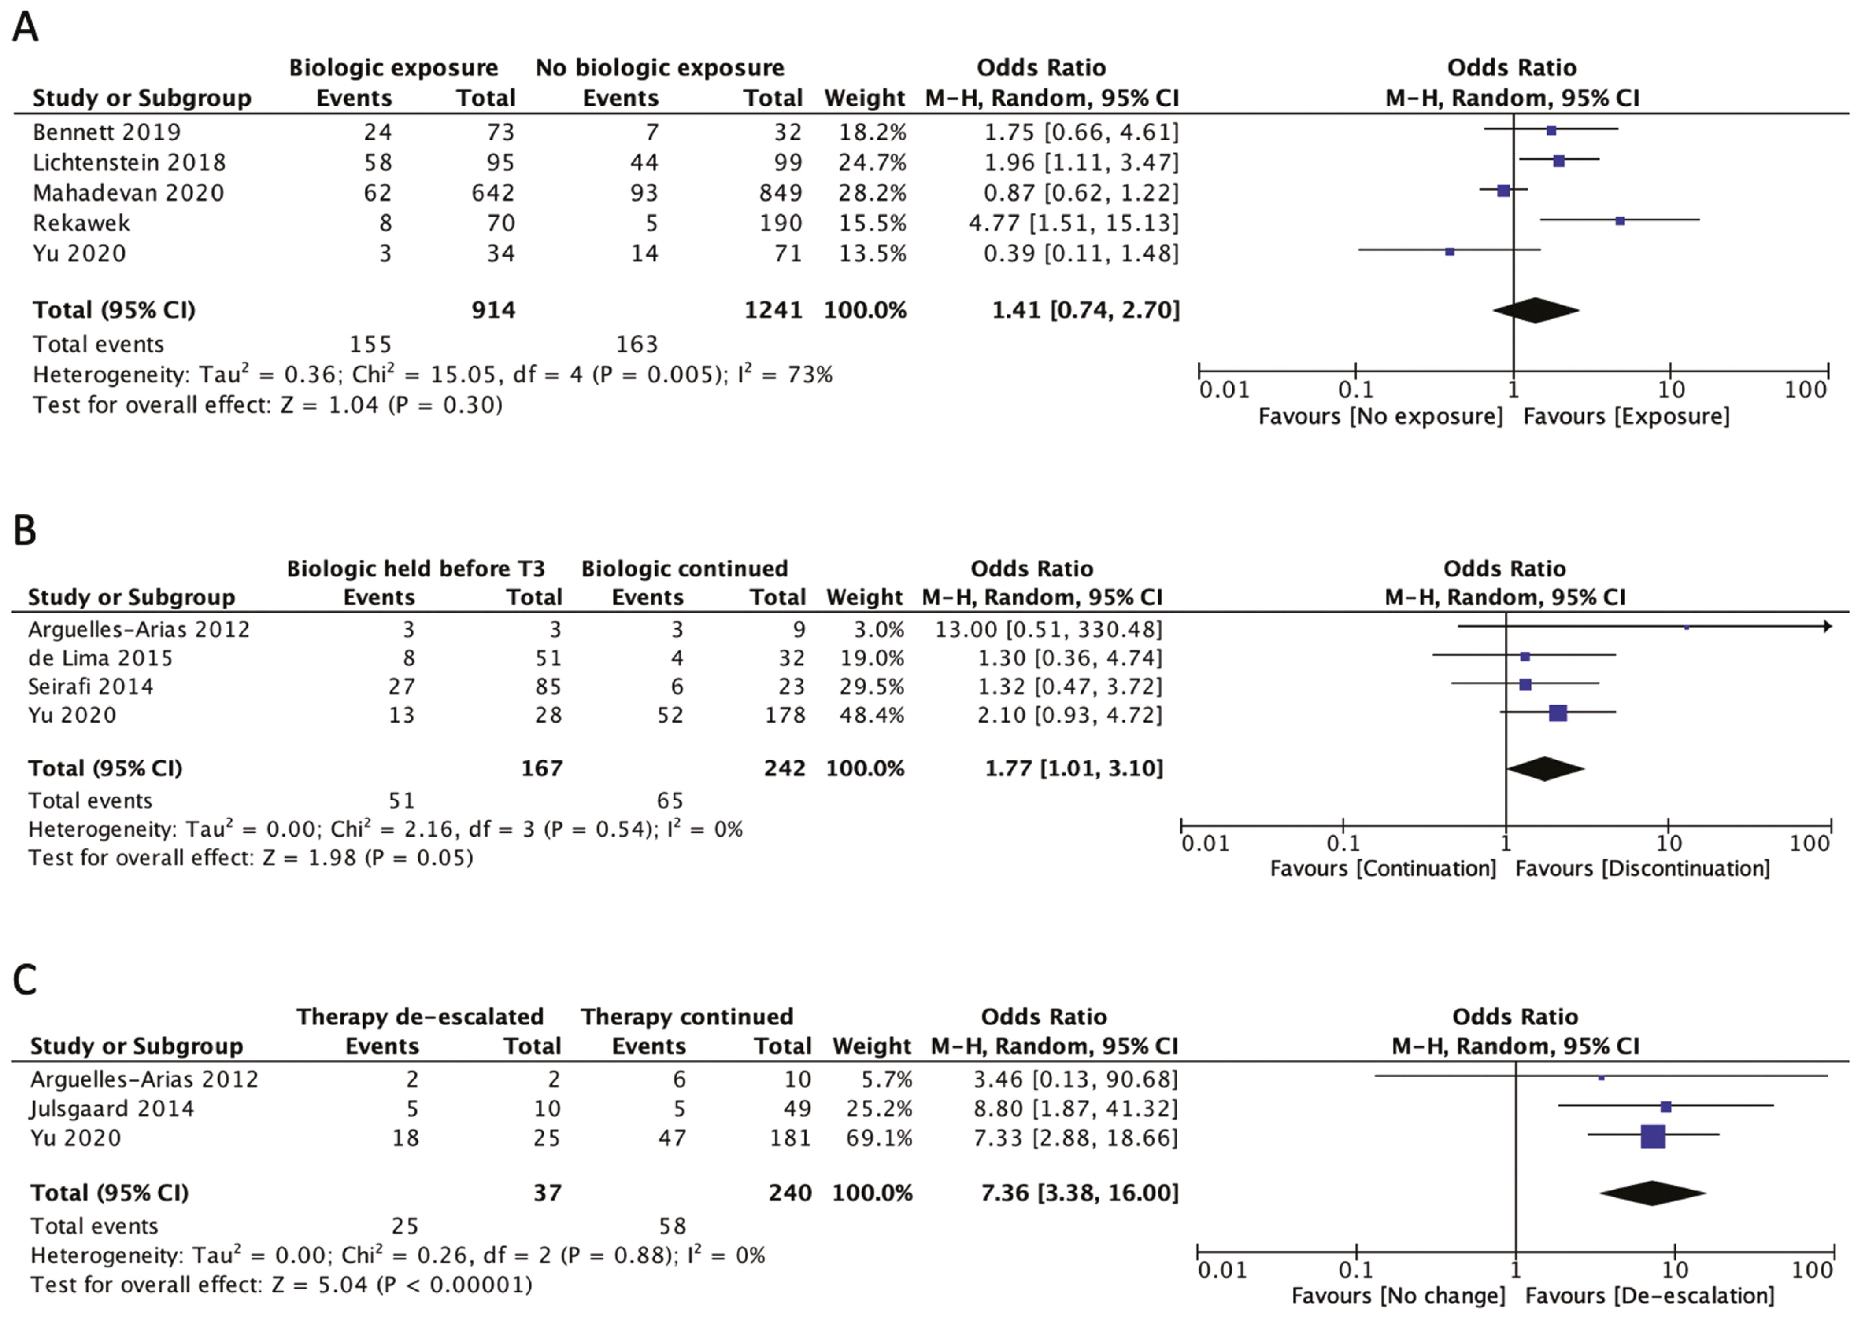

Stopping Biologics is Associated with Disease Flare: Systematic Review and Metanalysis
Malhi G Inflamm Bowel Dis 2022 Jul 1;28(7):1090-1099
Notes:
Figure 4. Relative odds of postpartum disease activity in women with IBD with (A) biologic exposure at any time point during pregnancy, (B) biologic discontinuation in the third trimester, and (C) biologic de-escalation postpartum.
Abstract
Background
Women with IBD (IBD) have an increased risk of postpartum disease activity. We aimed to systematically determine the effect of various risk factors on postpartum IBD disease activity.
Methods
Electronic databases were searched through January 2021 for studies that reported risk of postpartum disease activity in women with IBD. Pooled odds ratios (ORs) with 95% confidence intervals (CIs) were calculated for the impact of IBD phenotype, disease activity, therapy
de-escalation, mode of delivery, and breastfeeding on postpartum disease activity. Study bias was determined using the Quality in Prognostic Studies tool.
Results
Twenty-seven observational studies (3825 patients) were included, 15 of which had a high risk of confounding bias. The pooled incidence of women with postpartum active IBD was 31.9% (95% CI, 25.6–38.1). Similar results were seen with ulcerative colitis and Crohn’s disease (CD; OR, 0.96; 95% CI, 0.58–1.59). Those with stricturing (OR, 3.64; 95% CI, 1.31–10.08) and penetrating (OR, 4.25; 95% CI, 1.11–16.26) CD had higher odds of postpartum active IBD. Active disease at conception (OR, 10.59; 95% CI, 1.48–76.02) and during pregnancy (OR, 4.91; 95% CI, 1.82–13.23) increased the odds of postpartum disease activity. Similarly, biologic discontinuation in the third trimester (OR, 1.77; 95% CI, 1.01–3.10) and therapy de-escalation after delivery (OR, 7.36; 95% CI, 3.38–16.0) was associated with postpartum disease activity.
Conclusions
Complicated Crohn’s disease, disease activity at conception and during pregnancy, and de-escalation of biologics during pregnancy or after delivery are associated with postpartum disease activity in women with IBD
Unless provided in the caption above, the following copyright applies to the content of this slide: © 2021 Crohn’s & Colitis Foundation. Published by Oxford University Press. All rights reserved. For permissions, please e-mail: journals.permissions@oup.com.This article is published and distributed under the terms of the Oxford University Press, Standard Journals Publication Model (https://academic.oup.com/journals/pages/open_access/funder_policies/chorus/standard_publication_model)

Slide 51
GRADE Statement 12:
Level of Evidence: Low
For women with IBD who are pregnant or attempting conception, we recommend continuing maintenance 5-aminosalicylate therapy.
Recommendation: Strong
GRADE Statement 13:
Level of Evidence: Very Low
In women with IBD who are pregnant or attempting conception, we suggest continuing maintenance sulfasalazine therapy.
Recommendation: Conditional
GRADE Statement 14:
Level of Evidence: Low
In women with IBD who are pregnant, we suggest use of corticosteroid therapy when clinically necessary with appropriate monitoring.
Recommendation: Conditional
GRADE Statement 15:
Level of Evidence: Very Low
In women with IBD we recommend discontinuing maintenance methotrexate therapy prior to conception.
Recommendation: Strong
GRADE Statement 16:
Level of Evidence: Very Low
In women with IBD who are pregnant or attempting conception, we suggest continuing maintenance thiopurine therapy as data does not demonstrate an increased risk of congenital malformations or infant infections.
Recommendation: Conditional
Notes:
5-ASA and Sulfasalazine:
Continue during pregnancy.
If using sulfasalazine, prescribe 2 mg of folic acid (instead of 1 mg).
Corticosteroids:
Use only if necessary.
Do not rely solely on steroids for flare management if stopping anti-TNF therapy; this leads to poor outcomes.
Short-term steroid use during pregnancy is acceptable for flares.
Methotrexate:
Stop at least one month, ideally three months, before attempting conception.
Thiopurine:
Continue maintenance thiopurine throughout pregnancy, if needed.

Slide 52
GRADE Statement 17:
Level of Evidence:
Low
In women with IBD who are pregnant or attempting conception, we recommend continuing maintenance anti-tumor necrosis factor therapy throughout pregnancy.
Recommendation:
Strong
GRADE Statement 18:
Level of Evidence:
In women with IBD who are pregnant or attempting conception, we suggest continuing maintenance combination therapy with an anti-tumor necrosis factor and thiopurine therapy throughout pregnancy.
Very low
Recommendation:
Conditional
GRADE Statement 19:
Level of Evidence:
Low
In women with IBD who are pregnant or attempting conception, we suggest continuing maintenance vedolizumab therapy throughout pregnancy.
Recommendation:
Conditional
GRADE Statement 20:
Level of Evidence:
Low
In women with IBD who are pregnant or attempting conception, we suggest continuing maintenance ustekinumab therapy throughout pregnancy.
Recommendation:
Conditional
Notes:
Anti-TNF Therapy:
Continue throughout pregnancy to reduce maternal disease activity
and risk of preterm birth.
No increased risk of birth defects.
If needed, combination therapy with anti-TNF and thiopurine is safe.
Recommended to stop thiopurine if it’s not necessary.
Vedolizumab and Ustekinumab:
Continue maintenance therapy throughout pregnancy.

Slide 53
Consensus Statements
12. Women with IBD who are pregnant and with active disease should start or optimize the same appropriate therapies as in nonpregnant patients, except for thiopurines, methotrexate, janus kinase inhibitors
and sphingosine 1 receptor modulators.
13. In women with IBD who continue thiopurines during pregnancy, precaution should be taken for intrahepatic cholestasis by measurement of liver enzymes, metabolite levels and consideration of split dosing.
14. Women with IBD who are pregnant and have infections, fistula or pouchitis that require antibiotics
may take an appropriate course of a low-risk antibiotic.
Notes:
Therapy Continuation:
Continue IBD therapy throughout pregnancy; no need to stop at any point.
Treatment for Active Disease:
Pregnant women with active disease should start or optimize appropriate IBD therapies, similar to non-pregnant patients.
Do not start thiopurines (due to pancreatitis and bone marrow suppression risks), methotrexate, JAK inhibitors, or S1Ps during pregnancy.
In some cases, JAK inhibitors are an exception and may be started in the third trimester.
Thiopurines:
Monitor for intrahepatic cholestasis of pregnancy (new FDA warning).
Measure liver enzymes every trimester and check metabolite levels once; consider split dosing if elevated.
Antibiotics:
Appropriate low-risk antibiotics like amoxicillin/clavulanic acid may be used if required.

Slide 54
Consensus Statements
15. Women with IBD may initiate or continue calcineurin inhibitors (cyclosporine and tacrolimus) during pregnancy with careful monitoring if there are no viable alternate treatment options available.
16. Women with IBD who are pregnant or attempting conception should continue biosimilars
to existing biologics.
17. Women with IBD who are pregnant
or attempting conception should continue
anti-interleukin-23 therapy throughout pregnancy (mirikizumab, risankizumab, guselkumab).
Notes:
Other Therapies:
Calcineurin inhibitors can be used if no viable alternatives exist.
Continue biosimilars and anti-IL-23 therapy (e.g., risankizumab, guselkumab) during pregnancy or when attempting conception, though data is limited on newer agents.
Note on Risankizumab
First-time data shows risankizumab does transfer across the placenta.
The mother’s drug level is higher than the infant’s, resulting in a low transfer ratio which is unusual.
This is different from most monoclonal antibodies, where the infant typically
has higher drug levels due to efficient placental transfer and immature reticuloendothelial system.

Slide 55
Consensus Statements
Women with IBD should discontinue:
18. Ozanimod ( at least 3 months)
19. Etrasimod (at least 1-2 weeks)
20. Tofacitinib (at least 4 weeks)
21. Upadacitinib (at least 4 weeks)
22. Filgotinib (at least 4 weeks)
...prior to conception unless there is no effective alternative therapy to maintain maternal health
Notes:
Discontinue small molecules before conception:
Ozanimod: At least 3 months prior.
Etrasimod: At least 1-2 weeks prior.
Tofacitinib, Upadacitinib, Filgotinib: At least 4 weeks prior.
Important caveat:
Discontinue only if effective alternate therapy is available to maintain maternal health.
Some patients may need to continue these therapies through pregnancy
if no other options are available (e.g., cannot return to thiopurines).
Note on Tofacitinib:
Data from DDW: 85 maternal exposures to tofacitinib showed no increase in adverse events. Concern exists due to animal models where tofacitinib caused birth defects at super therapeutic doses.
Note on Upadacitinib:
A study of 128 pregnancies exposed to the drug showed only one congenital malformation (an atrial septal defect). While the data is insufficient, in some cases, with careful shared decision-making, the therapy may be continued or started later in pregnancy.

Slide 56
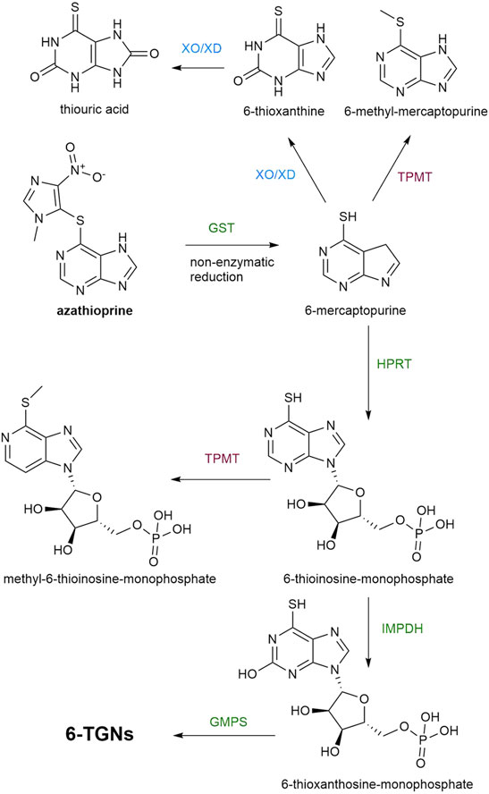
Consensus Statement 13: Thiopurines
Shunting to the 6-MMP pathway
Recent FDA announcement, 29 April 2024
“Rare risk of intrahepatic cholestasis of pregnancy”
Incidence of 1.1% in the general population
IBD data: Prentice 2024, Selinger 2023, Kanis 2021
Practical considerations
Split dosing of thiopurine; Allopurinol
co-therapy has limited safety data; Use
of thioguanine; or Biologic monotherapy
MMP:TGN increases over pregnancy
Jharap 2014, Flanagan 2021
Notes:
This aligns with the concerns that thiopurines have been linked to an increased risk of intrahepatic cholestasis of pregnancy, prompting an FDA warning, likely due to metabolite shunting.
Metabolite shunting means that the body's metabolism shifts to produce more
6-methylmercaptopurine (6-MMP) relative to thioguanine nucleotides (TGN).
This can increase the risk of hepatotoxicity (liver damage) because 6-MMP is associated with liver toxicity, while TGN is the metabolite that helps suppress
the immune response in conditions like IBD.
Measuring thiopurine metabolites in the second and third trimesters can help avoid elevated 6-MMP levels and hepatotoxicity.
FDA Announcement (April 2024):
Important to note that this is a very rare risk of intrahepatic cholestasis identified (only 1% incidence in the general population).
Recommendations:
Increase monitoring: Regular lab tests and metabolite levels.
Do not recommend allopurinol use.
Thiopurines are rarely used as monotherapy in the United States, but in some countries, it remains common due to cost factors.

Slide 57
IBD Medications from Pre-conception through Pregnancy
Medication | Pre-conception | 1st Trimester | 2nd Trimester | 3rd Trimester
Aminosalicylates Folic acid supplementation with Sulfasalazine | ✔︎ | ✔︎ | ✔︎ | ✔︎
Thiopurine | ✔︎ | ✔︎ | ✔︎ | ✔︎
Methotrexate Teratogen: Cessation 1-3 months prior to conception | ✕ | ✕ | ✕ | ✕
Corticosteroids Minimize use Employ steroid sparing therapy | ✔︎ | ✔︎ | ✔︎ | ✔︎

Slide 58
IBD Medications from Pre-conception through Pregnancy and Lactation
Medication | Pre-conception | 1st Trimester | 2nd Trimester | 3rd Trimester
Anti-Tumor Necrosis | ✔︎ | ✔︎ | ✔︎ | ✔︎
Anti-Integrin | ✔︎ | ✔︎ | ✔︎ | ✔︎
Anti IL-12/23 or Anti IL-23 | ✔︎ | ✔︎ | ✔︎ | ✔︎
JAK Inhibitors Avoid Use only if no other viable option for maternal health | ! | ! | ! | !

Slide 59
Consensus Statement 2: Antibiotics
Author | Year | Study Design | No signal for congenital malformations | Comments
Acar | 2019 | SRMA | Quinolones | 10 studies
Ziv | 2018 | SRMA | Quinolones | 12 studies
Yefet | 2018 | SRMA | Quinolones | 13 studies
Bar-Oz | 2009 | SRMA | Quinolones | 5 studies
Caro-Patón | 1997 | SRMA | Metronidazole | 5 studies
Burtin | 1995 | SRMA | Metronidazole | 5 studies
Bahri | 2023 | SRMA | Amoxycillin +/- clavulanic acid | 4 studies

Slide 60
Risankizumab Placental Transfer
Serum Concentration (mcg/ml)
Patient | 1 | 2 | 3
Second Trimester Trough | 20.10
Mother | 28.60 | 9.48 | 12.11
Umbilical Cord Blood | 5.96 | 3.19 | 4.14
Infant | 6.53 | 3.12 | --
Ratio Infant/Cord: Mother | 0.23 | 0.33 | 0.34
Mahadevan et al Inflamm Bowel Disease 2024

Slide 61


Pregnancies in the tofacitinib overall and UC clinical programs
In the overall global tofacitinib clinical program,ª a total of 184 pregnancies were identified:
  Maternal exposure: 85
  Paternal exposure: 99
There were 40 pregnancies in the tofacitinib UC clinical program:
Maternal exposure
Paternal exposure
Median age
Number of days between the last menstrual period and last tofacitinib dose:
24 cases of
paternal exposure
(included 2 cases from
the same patient)
16 cases of
maternal exposure
29.5 years
64 and 106 days
6–69 days
(range 24–41)
Tofacitinib 5 mg BID
(2 patients)
Tofacitinib 10 mg BID
(12 patients)
ªIncludes RA, PsA, AS, JIA, UC and PsO clinical programs
AS, ankylosing spondylitis; BID, twice daily; JIA, juvenile idiopathic arthritis; PsA, psoriatic arthritis; PsO, psoriasis; RA, rheumatoid arthritis; UC, ulcerative colitis
DDW 2024: Mahadevan
Notes:
ªIncludes RA, PsA, AS, pJIA, UC and PsO clinical programs (including completed, controlled studies and LTE studies from each disease clinical program); ^{b}Two previously reported maternal exposure cases (pregnancy reported on Oct 14, 2015 and Dec 17, 2016) were determined to be invalid in the Argus safety database as the patients elected to terminate the pregnancy and no adverse events were associated (Mahadevan U et al. Inflamm Bowel Dis 2018; 24: 2494-2500); ^{c}Data not available for 1 patient; ^{d}Data for 3 patients based on estimated date of conception; data not available for 1 patient; ^{e}Partner’s pregnancy; ^{f}For clarification, in 4 out of 24 pregnancy cases (16.7%), although reported as maternal exposure during pregnancy, the study drug was actually taken by the father as these were the partner’s pregnancy cases

Slide 62
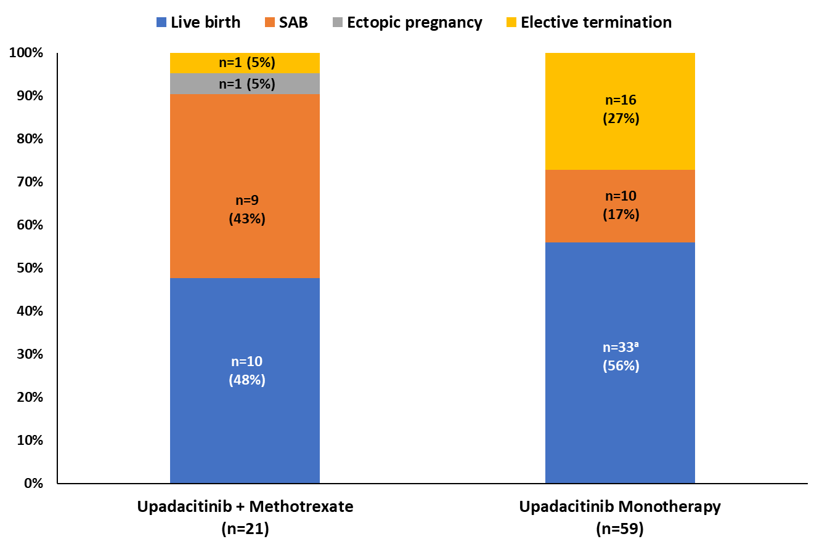
Pregnancy Outcomes in Patients Treated With Upadacitinib:
Analysis of Data From Clinical Trials and Postmarketing Reports
Animal Reprotoxicity Data
1.6x, 15x [15 mg QD]
0.8x, 7.6x [30 mg QD]
0.6x, 5.6x [45 mg QD]
N= 128 maternal UPA-exposed pregnancies
Clinical trials n=80
  Mean in utero exposure 5 wks, 3d
    Live births (54%)
    SAB (24%)
    TAB (21%)
    Ectopic pregnancy (1%)
    1 congenital malformation
      Atrial septal defect
Postmarketing cases n=48
  Live births (46%)
  Spontaneous abortions (38%)
  Elective terminations (15%)
  Ectopic pregnancy (2%)
Clinical Trials
Mahadevan et al Drug Saf. 2024
Notes:
Rate of ectopic pregnancies: 1-2% nationally
Background: Upadacitinib is indicated for diseases affecting persons of childbearing potential including rheumatoid arthritis, psoriatic arthritis, axial spondyloarthritis, atopic dermatitis, Crohn’s disease, and ulcerative colitis; however, teratogenicity was observed in animal studies. Given the potential for human fetal risk, pregnancy avoidance measures were required during clinical trials. This analysis describes pregnancy outcomes in patients exposed to upadacitinib during pregnancy.
Methods: Clinical trial and postmarketing cases of in utero exposure to upadacitinib were identified in AbbVie’s safety database through April 25, 2023. Analysis of clinical trial cases and postmarketing reports are presented separately; prospective and retrospectively reported pregnancy outcomes are integrated for each. Descriptive rates are presented to summarize outcomes.
Results: There were 128 maternal upadacitinib-exposed pregnancies with known outcomes identified; 80 and 48 pregnancies were reported in clinical trials and the postmarketing setting, respectively. In clinical trials (mean in utero exposure of 5 weeks, 3 days), live births (54%), spontaneous abortions (24%), elective terminations (21%), and ectopic pregnancy (1%) were reported. There was one report of a congenital malformation: a 35-week infant with an atrial septal defect. In postmarketing cases, live births (46%), spontaneous abortions (38%), elective terminations (15%), and ectopic pregnancy (2%) were reported.
Conclusions: As the data are limited for in utero exposure to upadacitinib, definitive conclusions cannot be drawn regarding the effect of upadacitinib on pregnancy outcomes. Rates of adverse pregnancy outcomes with upadacitinib exposure were comparable to rates observed in the general population or patients with autoimmune inflammatory diseases. To date, no apparent evidence of teratogenicity exists in the analyses of human pregnancies exposed to upadacitinib during the first trimester.

Slide 63
Maternal factors impacting pregnancy
Fertility
Pre-conception counseling and optimization
Management of
disease activity
during pregnancy
Management
of pregnancy
IBD medications
during pregnancy
IBD medications
during lactation
Pregnancy
adverse events
Fetal and neonatal adverse events
Vaccines
Notes:
Lactation management for women with IBD largely mirrors pregnancy guidelines, with most medications being considered safe for breastfeeding.

Slide 64
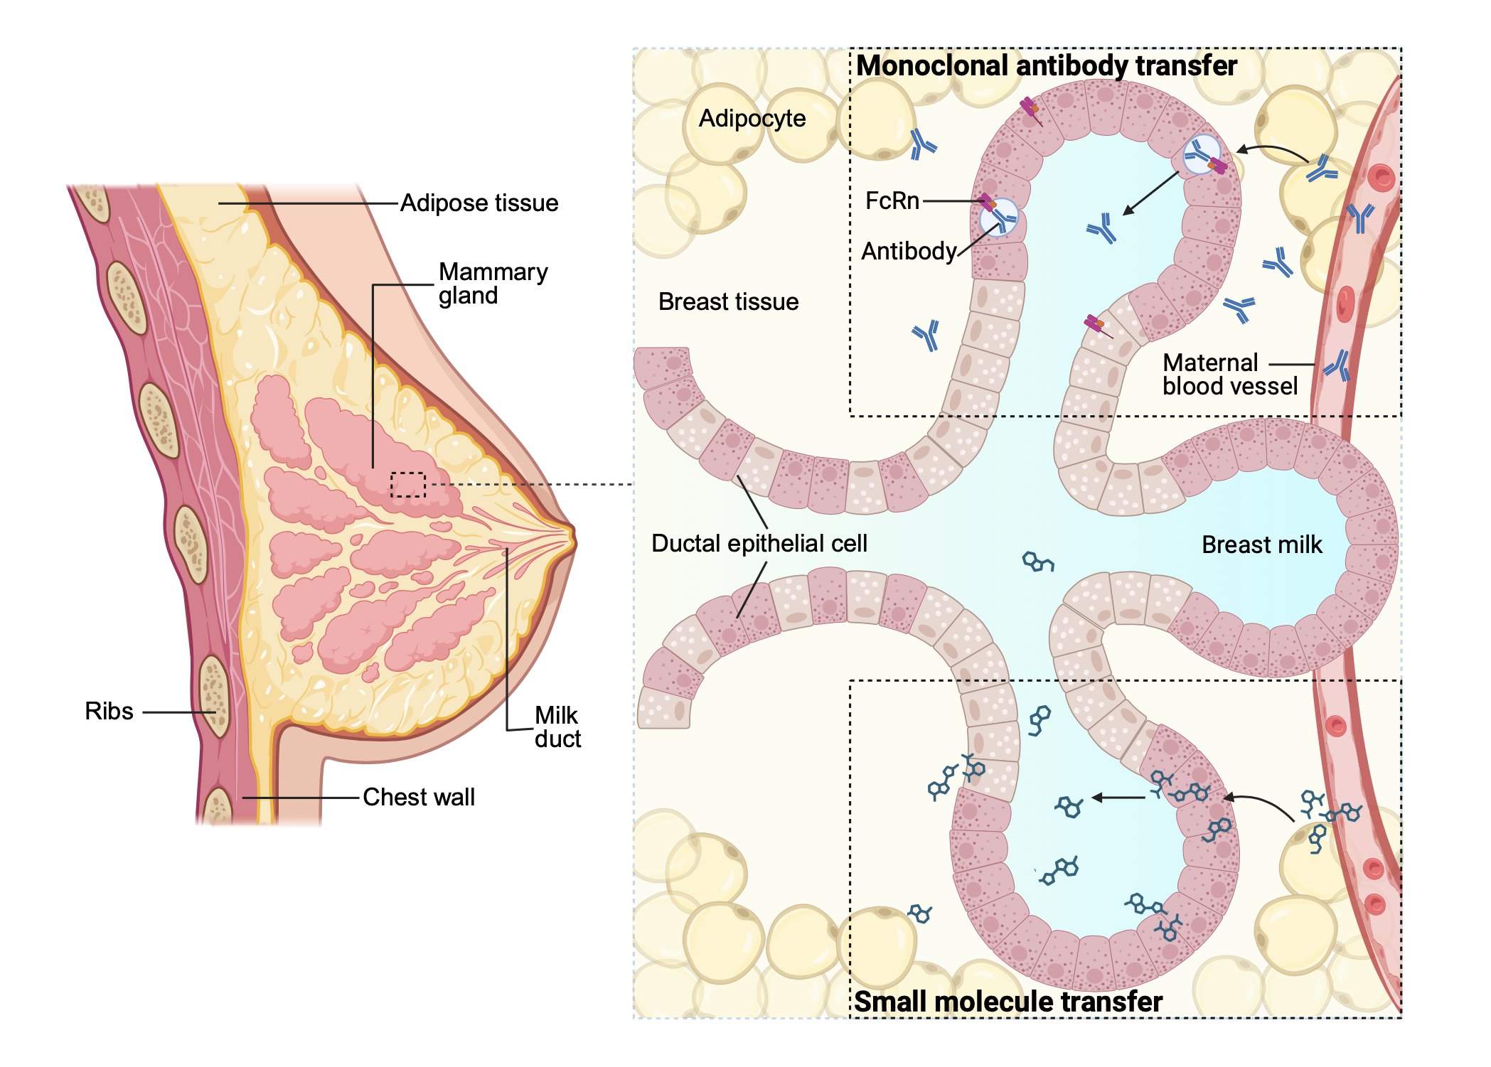
The transfer
of monoclonal antibodies and small molecules from the maternal blood into breast milk during lactation.
Global Consensus Manuscript 2024
Notes:
This image illustrates how monoclonal antibodies and small molecules are transferred from the maternal blood into breast milk during lactation.

Slide 65
Monoclonal antibodies (mAbs) & breastfeeding
The estimated infant mAb exposure via breastmilk (Relative Infant Dose)
< 1%
~50% digested²
<0.5%
~0.01% absorbed
<0.005%
100%
Studies of mAbs used
in IBD¹
radiolabeled IgG
(after day 4)³
Maternal
Serum
Milk
Infant
GI-tract
Infant
Serum
For most drugs, a weight-adjusted percentage of
the maternal dosage (Relative Infant Dose) of ≤ 10%
is considered relatively safe.^{1,2}
In infants exposed in utero to infliximab, adalimumab, vedolizumab or ustekinumab, maternal breastfeeding did not affect neonatal clearance of the drug.⁴⁻⁶
1.LaHue SC et al. Neurol Neuroimmunol Neuroinflamm 2020 , 2.Sah BNP et al. Front Nutr. 2020,
3.Krysko KM et al. Lancet Neurol 2023, 4.Julsgaard M et al. Gastroenterology 2016,
5.Julsgaard M et al. AP&T 2021, 6.Julsgaard M et al. Clin Gas Hep 2024.
Notes:
Lactation and Medication Use:
Similar rules apply as in pregnancy for IBD medications.
Lactation is more optional, and mothers can choose not to breastfeed if on certain medications (e.g., JAK inhibitors).
The figure demonstrates that although monoclonal antibodies are present in the mother’s bloodstream, only a minuscule amount is transferred to the infant through breastfeeding. The combination of low transfer into milk, digestion in the infant’s gut, and limited absorption leads to minimal infant exposure to monoclonal antibodies.
Maternal Serum (100%)
Milk (<1%)
Infant GI Tract (~50% digested)
Absorption from GI Tract (<0.5%)
Infant Serum (<0.005%)
Relative Infant Dose:
The relative infant dose (estimated exposure to the drug through breast milk)
is important.
A medication is considered appropriate for breastfeeding if the relative infant dose is less than 10%.
For monoclonal antibodies and IBD drugs, the relative infant dose generally appears to be under 10%.
In infants exposed in utero to infliximab, adalimumab, vedolizumab, or ustekinumab, maternal breastfeeding did not impact the clearance of the drug in the neonate.

Slide 66
Level of Evidence:
GRADE Statement 21:
Very low
We recommend breastfeeding as it is NOT associated with an increased
risk of disease exacerbation in women with IBD.
Recommendation:
Strong
Level of Evidence:
GRADE Statement 22:
Very low
We suggest counseling that infants born to mothers on anti-tumor necrosis factor therapy who breastfeed have no increased risk of infection in the first 12 months of life.
Recommendation:
Conditional
Notes:
Breastfeeding and IBD:
Breastfeeding is not associated with an increased risk of disease exacerbation
in women with IBD.
Infants and Anti-TNF Therapy:
Infants born to mothers on anti-TNF who breastfeed do not have an increased
risk of infection.
Early data clarification:
Initial data suggested a flare risk with breastfeeding, but this was related
to mothers stopping their medications, not the breastfeeding itself.

Slide 67
Consensus Statements
Mothers with IBD currently on:
23. 5-aminosalicylates/sulfasalazine
24. Thiopurines
25. Corticosteroids
26. Anti-tumor necrosis factor agents (Infliximab, adalimumab, golimumab, certolizumab)
27. Anti-integrins (vedolizumab, natalizumab)
28. Anti-interleukin-12/23 and anti-interluekin-23 (ustekinumab, risankizumab, mirikizumab, guselkumab).
29. Biosimilars
…may breastfeed
Notes:
Breastfeeding is considered safe for mothers taking:
5-ASAs, sulfasalazine, thiopurines, corticosteroids, anti-TNFs, anti-integrins,
anti-IL-23s, and biosimilars.

Slide 68
Consensus Statements
30. Mothers with IBD currently on sphingosine 1 receptor modulators (etrasimod or ozanimod) should not breastfeed .
31. Mothers with IBD currently on janus kinase inhibitors (tofacitinib, upadacitinib, filgotinib) should not breastfeed.
Notes:
Avoid breastfeeding for mothers on:
S1Ps or JAK inhibitors.
Data shows higher levels of tofacitinib in breast milk compared to maternal serum, though the relative infant dose is low (3.4%).

Slide 69

Safe to Breastfeed On
Avoid Breastfeeding On
5-ASAs
S1Ps
Sulfasalazine
JAK inhibitors
Thiopurines
Methotrexate
Corticosteroids
Anti-TNFs
Anti-integrins
Anti-IL-23s
Biosimilars
Notes:
Safe to Breastfeed On:
5-ASAs (e.g., mesalamine)
Sulfasalazine
Thiopurines (e.g., azathioprine, mercaptopurine)
Corticosteroids (e.g., prednisone)
Anti-TNFs (e.g., infliximab, adalimumab)
Anti-integrins (e.g., vedolizumab)
Anti-IL-23s (e.g., ustekinumab)
Biosimilars (of the above drugs)
Avoid Breastfeeding On:
S1Ps (Sphingosine 1-phosphate receptor modulators)
JAK inhibitors (e.g., tofacitinib)
Notes on Tofacitinib: Higher levels found in breast milk compared to maternal serum, but relative infant dose is still low (3.4%).

Slide 70
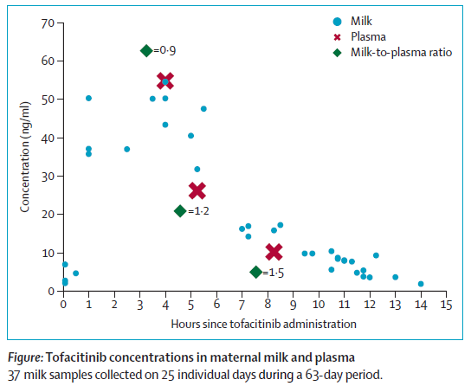
JAK-inhibitors & breastfeeding
Tofacitinib
Detectable in breastmilk of 2 lactating women
  5 and 10 mg BID, respectively^{1,2}
"Worst-case": Relative Infant Dose 3.4%^{1,2}
3 infants exposed to tofacitinib during pregnancy/breastfeeding → normal development^{2,3}
  1 infant: normal immunological assessment at 3 months of life. ³
Upadacitinib & filgotinib
No available human lactation data
EMA & FDA recommend avoidance of breastfeeding.^{4,5}
Recommendation
Due to no/limited human safety data including unknown effects on the immune system of the suckling infant, breastfeeding should be avoided
in case of treatment with a JAK-inhibitor
Ref. 1
1. Julsgaard M et. al. Lancet Gas Hep 2023, 2. Mitrova K et. al. Clin Gas Hep 2024,
3. Ernest-Suarez K et. al. Inflamm Bowel Dis 2024. 4. www.ema.europa.eu 5. www.accessdata.fda.gov
Notes:
RID 3.4% of the maternal weight-adjusted dosage. = higher than reported for other IBD drugs +
Bioavailability from the GUT is 93% → ↑ absorption from the infants gut.

Slide 71
Maternal factors impacting pregnancy
Fertility
Pre-conception counseling and optimization
Management of
disease activity
during pregnancy
Management
of pregnancy
IBD medications
during pregnancy
IBD medications
during lactation
Pregnancy
adverse events
Fetal and neonatal adverse events
Vaccines
Notes:
Women with IBD face higher risks during pregnancy, including increased rates of low birth weight, preterm delivery, and spontaneous abortion, especially in cases of active disease.

Slide 72
GRADE Statement 23:
Level of Evidence:
We suggest counseling that women with IBD as compared to women without IBD have an increased risk of adverse pregnancy outcomes including low birth weight
and preterm delivery.
Very low
Recommendation:
Conditional
GRADE Statement 24:
Level of Evidence:
We suggest counseling that women with IBD with moderate to severe disease activity have an increased risk of spontaneous abortion as compared to women without IBD
or women with mild IBD.
Very low
Recommendation:
Conditional
GRADE Statement 25:
Level of Evidence:
Low
We suggest counseling that pregnant women with IBD have an increased risk of venous thromboembolism during pregnancy as compared to pregnant women without IBD.
Recommendation:
Conditional
GRADE Statement 26:
Level of Evidence:
Low
We suggest counseling that pregnant women with IBD have an increased risk of venous thromboembolism during the postpartum as compared to pregnant women without IBD.
Recommendation:
Conditional
Notes:
Adverse events in pregnancy (women with IBD vs. women without IBD):
Higher rates of low birth weight and preterm delivery.
Increased risk of spontaneous abortion in women with moderate to severe
active disease.
Venous Thromboembolism (VTE):
Pregnant women with IBD have a higher risk of VTE during pregnancy and postpartum compared to pregnant women without IBD.
Important to discuss with OB/MFM teams, especially if a C-section is planned.
Consider VTE prophylaxis during hospitalization and postpartum, particularly
for C-section patients.
All IBD patients admitted should receive VTE prophylaxis, and this is even more crucial if they are pregnant.

Slide 73
Consensus Statements
32. Controlling disease activity during pregnancy among women with IBD is critical to reduce adverse outcomes.
Notes:
Controlling disease activity during pregnancy among women with IBD is critical to reduce adverse outcomes.

Slide 74
Maternal factors impacting pregnancy
Fertility
Pre-conception counseling and optimization
Management of
disease activity
during pregnancy
Management
of pregnancy
IBD medications
during pregnancy
IBD medications
during lactation
Pregnancy
adverse events
Fetal and neonatal adverse events
Vaccines
Notes:
Infants born to women with IBD are at a higher risk for complications such as low birth weight, preterm birth, and NICU admission, particularly when the disease is active.
However, treatment with certain medications like biologics or immunosuppressants does not increase the risk of developmental delays or early childhood health issues.

Slide 75
Level of Evidence:
GRADE Statement 27:
Very Low
We suggest counseling that children born to women with IBD have an increased rate of neonatal ICU admissions and hospitalizations in the first year of life compared to children born to women without IBD.
Recommendation:
Conditional
Level of Evidence:
GRADE Statement 28:
Very low
We suggest counseling that children born to women with active IBD have an increased rate of small for gestational age and low birth weight compared to children born to women with inactive IBD .
Recommendation:
Conditional
Level of Evidence:
GRADE Statement 29:
Very low
We suggest counseling that children born to women treated with
anti-tumor necrosis factor therapy, ustekinumab or vedolizumab during pregnancy have no increased risk for early childhood malignancy.
Recommendation:
Conditional
Notes:
Increased Risk for Infants Born to Women with IBD:
Higher likelihood of low birth weight (LBW), small for gestational age (SGA),
and preterm birth.
These factors increase the risk of NICU admission.
Complications are 2-3 times more likely with active disease.
No Increased Risk for children born to mothers treated with:
Anti-TNFs, ustekinumab, vedolizumab, or thiopurines.
No increased risk of early childhood malignancy or developmental delay.

Slide 76
Level of Evidence:
GRADE Statement 30:
Very low
We suggest counseling that children born to women treated with
anti-tumor necrosis factor therapy, ustekinumab or vedolizumab during pregnancy have no increased risk for early childhood developmental delay.
Recommendation:
Conditional
Level of Evidence:
GRADE Statement 31:
Very low
We suggest counseling that children born to women treated with thiopurine therapy during pregnancy have no increased risk for early childhood developmental delay.
Recommendation:
Conditional

Slide 77


Pregnancy and Neonatal Adverse Events
Increased risk of
pre-term delivery
Increased risk
of spontaneous abortion with
active disease
Increased risk
of venous thromboembolism
Increased risk of low birth weight with active maternal IBD
Increased risk of Neonatal intensive care unit
Increased risk of small for gestational age with active maternal IBD
Notes:
Increased risk of low birth weight with active maternal IBD (IBD)
Increased risk of neonatal intensive care unit (NICU) admission
Increased risk of small for gestational age (SGA) with active maternal IBD
Increased risk of pre-term delivery
Increased risk of spontaneous abortion with active disease
Increased risk of venous thromboembolism (VTE)

Slide 78
Maternal factors impacting pregnancy
Fertility
Pre-conception counseling and optimization
Management of
disease activity
during pregnancy
Management
of pregnancy
IBD medications
during pregnancy
IBD medications
during lactation
Pregnancy
adverse events
Fetal and neonatal adverse events
Vaccines
Notes:
Vaccinations play a crucial role in protecting both mothers and their infants from preventable diseases.
Infants born to mothers with IBD, especially those exposed to biologics or immunosuppressive therapies in utero, may have altered immune responses.
Both inactive and live vaccines can be administered safely, but timing and specific recommendations may vary based on maternal medications and disease status.

Slide 79
Level of Evidence:
GRADE Statement 32:
Very Low
We recommend that inactive vaccines be provided to children born
to mothers with IBD on anti-tumor necrosis factor agents.
Recommendation:
Strong
Level of Evidence:
GRADE Statement 33:
Very low
We suggest that live rotavirus vaccine may be provided in children with
in-utero exposure to biologics.
Recommendation:
Conditional
Level of Evidence:
GRADE Statement 34:
Very low
We recommend that live Bacillus Calmette-Guérin vaccine be avoided in the first 6 months* of life in children with in-utero exposure to anti-tumor necrosis factor therapy due to risk of disseminated tuberculosis and associated mortality.
*Regional risk should be considered
Recommendation:
Strong
Notes:
Inactive vaccines:
Children born to mothers with IBD on anti-TNFs show comparable efficacy
and safety with inactive vaccines as those without anti-TNF exposure.
Live vaccines:
Rotavirus vaccine may be given to children exposed to anti-TNFs and other biologics in utero.
93% exposed in the 3rd T.
No clinical significant abnormalities were detected in the vast majority
of infants.
BCG vaccine should be avoided in the first 6 months for children with in utero exposure to anti-TNFs.
Unlike the rotavirus vaccine, the Bacille Calmette-Guérin (BCG) vaccine
is more vital in some parts of the world where it is given within the first month of life, as well as more dangerous to the biologic exposed infant.
In high-risk countries where BCG must be given early, serum concentrations of drug can be measured prior to vaccination and consideration can be given to holding the biologic in the mother in
mid-pregnancy to reduce transfer to the infant.

Slide 80
Consensus Statements
33. Inactive vaccines should be given on schedule
to infants of women with IBD regardless of in utero IBD medication exposure.
34. Children exposed to janus kinase inhibitors or sphingosine 1 receptor modulators in utero may receive live vaccines after one month of age.
35. Live vaccines can be given to infants of mothers breastfeeding while on biologics.
Notes:
Inactive vaccines:
Should be given on schedule to all infants, regardless of in utero IBD medication exposure.
Live vaccines:
Can be given to infants exposed to JAK inhibitors or S1Ps in utero after one month, as these drugs clear the system within a month.
Contrary to the European Medicines Agency (EMA), live vaccines can be given
to infants while the mother is breastfeeding on biologics, including infliximab.

Slide 81

Live attenuated Rotavirus vaccine
Infants exposed in utero to anti-TNF
309 infants → live attenuated Rotavirus vaccine → no serious adverse events.¹⁻⁵
Systematic review and meta-analysis: low risk of minor adverse event (fever/diarrhea) (6/46, 15%).³
Canadian Immunization Research Network:⁴
  IFX (67/191 [35%]), ADA (49 [26%]), UST (18 [9%]), VDZ (17 [9%])
191 exposed
178 (93%) in T3
187 recommend
to vax
168 initiated rotavirus vaccine
No serious adverse reactions
1. Chaparro et al. J Crohns Colitis. 2023, 2. Benchimol et al. J Can Assoc Gastroenterol. 2021,
3. Goulden et al. Rheumatology (Oxford). 2022;
4. Fitzpatrick et al. Lancet Child Adolesc Health. 2023,
5. Gisbert et al. J Crohns Colitis. 2023
Notes:
93% exposed in the 3rd T.
No clinical significant abnormalities were detected in the vast majority of infants.

Slide 82
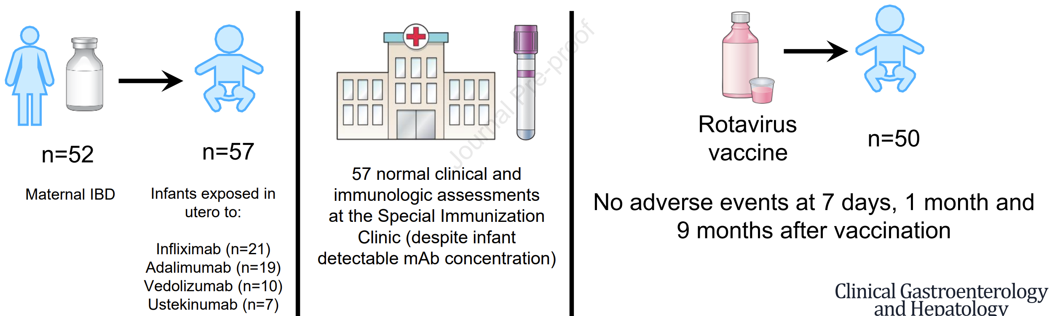
IBD Data: Safety Rotavirus Vaccine
Live Rotavirus Vaccination Appears Low-risk in Infants Born to Mothers with IBD
on Biologics
Ernest Suarez et al. Clin Gastroenterol Hepatol. 2024 Jul 30
Notes:
Live Rotavirus Vaccination Appears Low-risk in Infants Born to Mothers with IBD
on Biologics:
IBD and biologic exposure:
52 mothers with IBD and 57 infants exposed to biologics (Infliximab, Adalimumab, Vedolizumab, Ustekinumab).
Clinical assessments:
57 infants had normal clinical and immunological assessments at a special immunization clinic, despite infant-detectable monoclonal antibody concentrations.
Rotavirus vaccine:
50 infants received the Rotavirus vaccine, with no adverse events observed at 7 days, 1 month, and 9 months after vaccination.

Slide 83

Lancet Study: Safety Rotavirus Vaccine
Rotavirus vaccination can be offered to infants exposed to anti-TNF agents in utero
191 infants enrolled
93% exposed into the
3rd trimester
  Biologic exposure:
  Infliximab: 67 infants
  Adalimumab: 49 infants
  Ustekinumab: 18 infants
  Vedolizumab: 17 infants
No clinically significant abnormalities in lymphocyte subsets, quantitative immunoglobulins, or mitogen responses were detected.
Rotavirus vaccine recommended for 98% (187/191), initiated by 168 infants (90%), with 150 (80%) completing the series.
No serious adverse events reported after vaccination.
1. Fitzpatrick, TiffanyCowan, Juthaporn et al. 2. The Lancet Child & Adolescent Health, Volume 7, Issue 9, 648 - 656
Notes:
Lancet Study: 202 infants assessed, 191 enrolled (93% exposed into the 3rd trimester).
Biologic exposure:
Infliximab: 67 infants (35%)
Adalimumab: 49 infants (26%)
Ustekinumab: 18 infants (9%)
Vedolizumab: 17 infants (9%)
Clinical Assessment:
No clinically significant abnormalities in lymphocyte subsets, quantitative immunoglobulins, or mitogen responses detected.
Vaccination:
Rotavirus vaccine recommended for 98% (187/191), initiated by 168 infants (90%), with 150 (80%) completing the series.
No serious adverse events reported after vaccination.

Slide 84
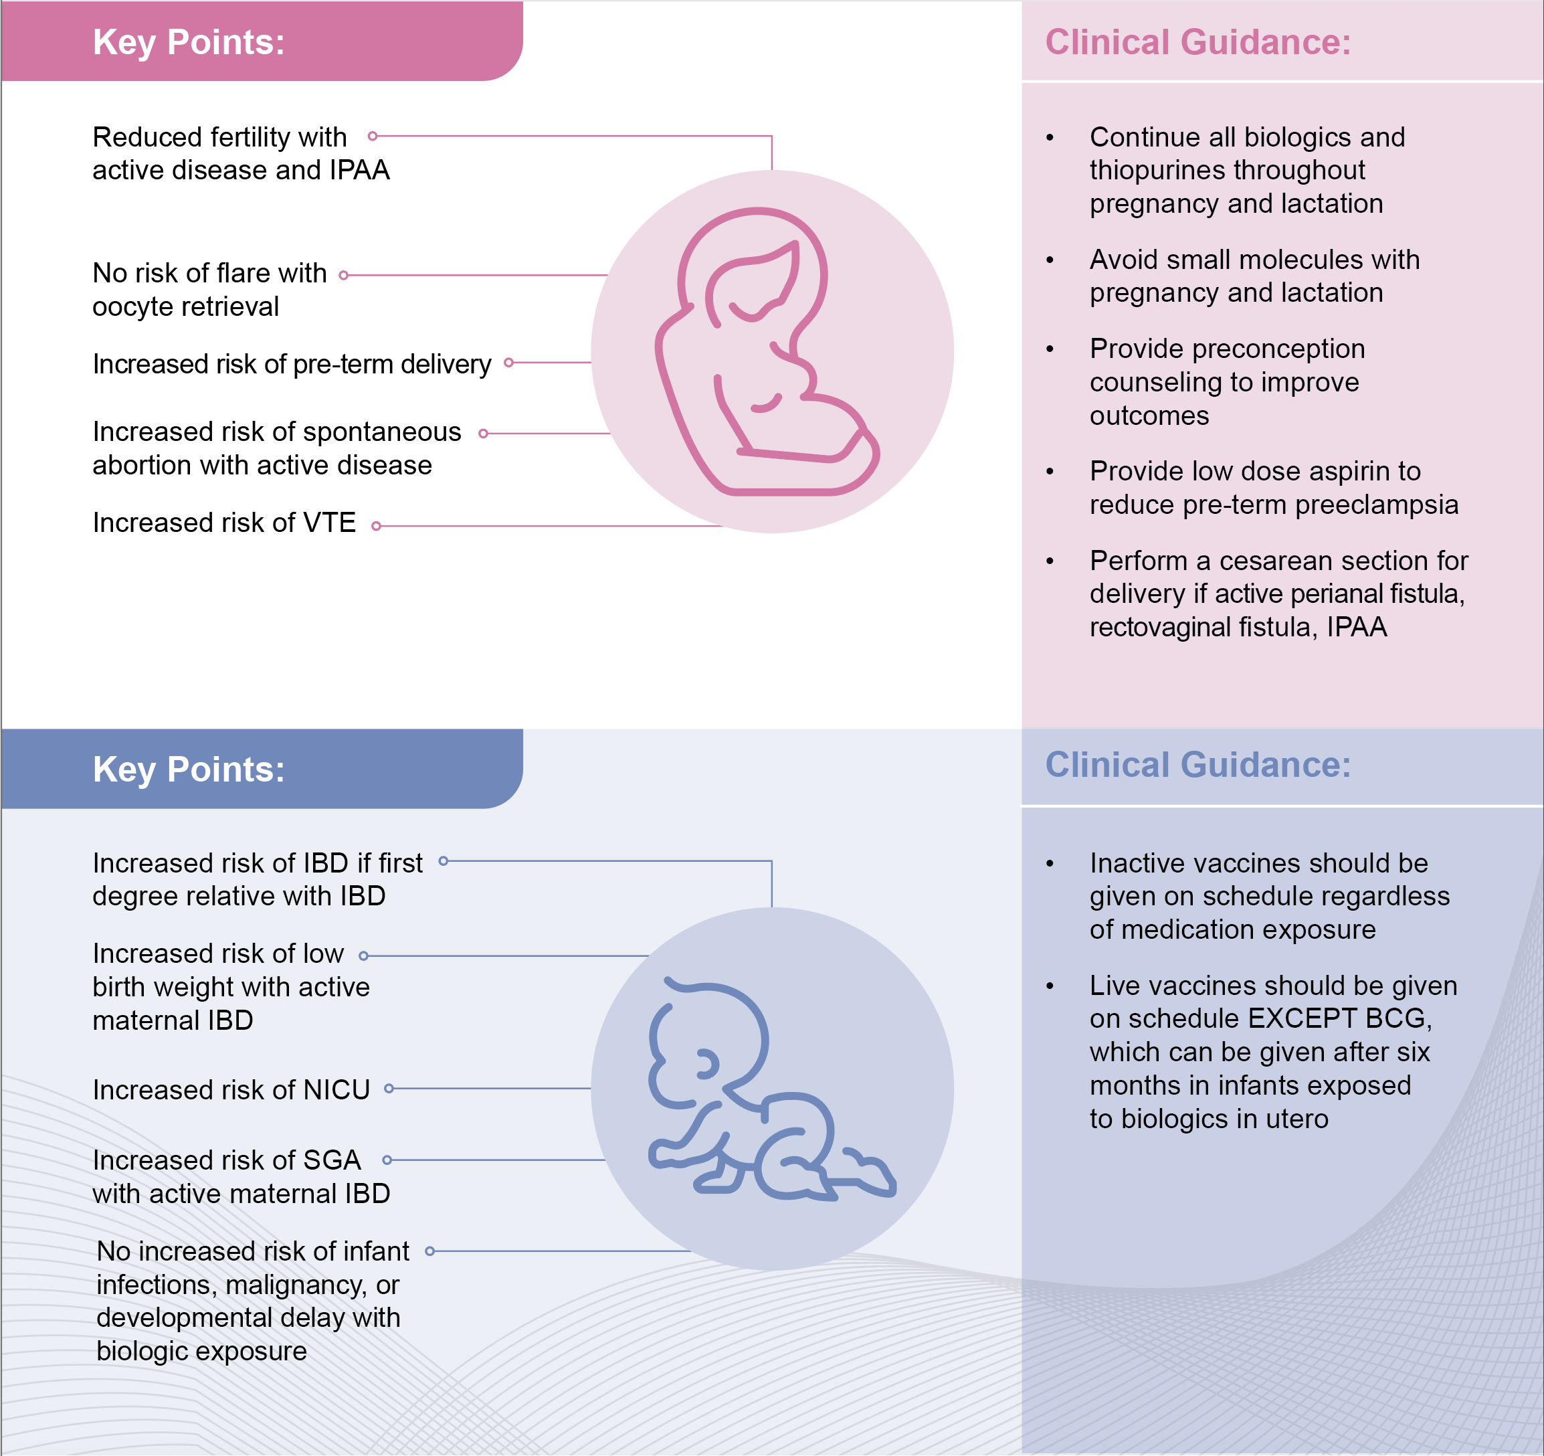
Summary

Slide 85
Summary

Slide 86
Questions?
To enroll in the PIANO registry for US residents: pianostudy.org
Slide Decks (English/Spanish)
Patient Videos (7 languages)
AIBDN Videos

